Slide 1
ANTIOXIDANTS

Slide 2
CONTENTS

Slide 3
INTRODUCTION

Slide 5
Antioxidants:

Slide 6
REDOX BALANCE

Slide 7
FREE RADICALS

Slide 8
FREE RADICALS

Slide 9
EFFECTS OF FREE RADICALS

Slide 10
SUPEROXIDES

Slide 11
NITRIC OXIDE

Slide 13
Hydrogen Peroxide

Slide 14
Hydroxyl Radical

Slide 15
Counteracting free radical damage:

Slide 16
MECHANISMS OF TISSUE DAMAGE

Slide 17
Protein damage

Slide 18
Lipid peroxidation

Slide 19
DNA damage

Slide 20
Ideal antioxidants:

Slide 21
Mechanisms by which antioxidants may offer protection

Slide 22
Antioxidants can be categorized by several methods:

Slide 24
Ascorbic acid (Vitamin C)

Slide 25
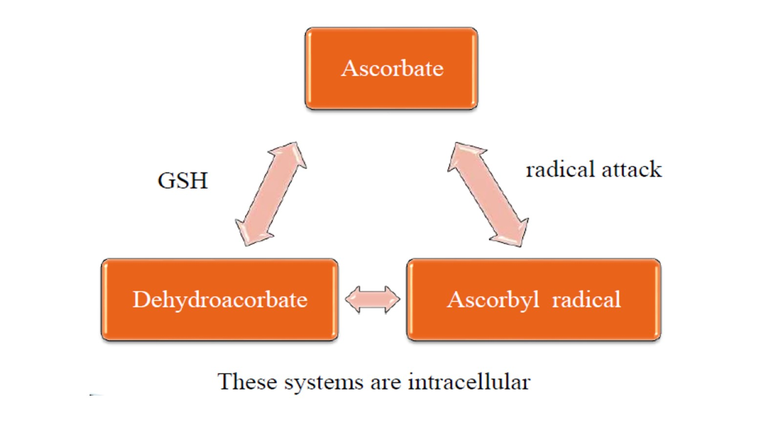

Slide 26
α-Tocopherol (vitamin E)

Slide 29
Carotenoids

Slide 30
Lycopene

Slide 32
Polyphenols (Flavenoids)

Slide 33
Other sources of Antioxidants are:

Slide 34
Uric acid

Slide 35
Reduced Glutathione

Slide 37
Superoxide Dismutase

Slide 38
Thank you

