Slide 1
PBS EXAMINATION OF BLOOD
DR. PRAHALAD SHARMA
MD

Slide 4
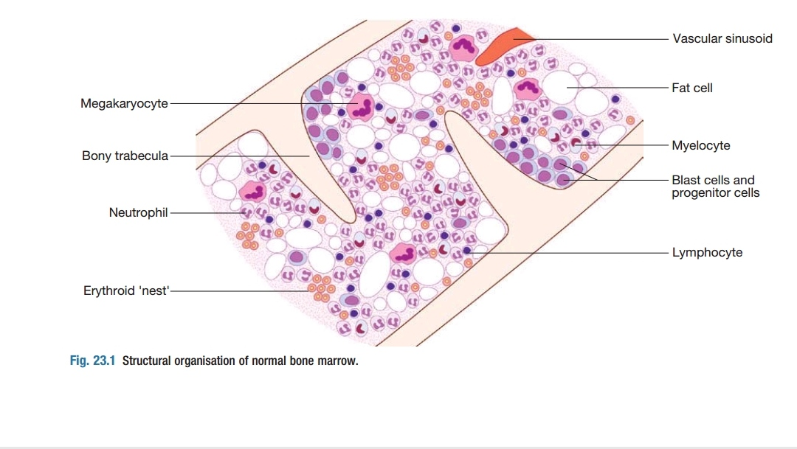
Peripheral blood smear examination
Dr. Prahalad sharma

