Slide 1
HISTOLOGY Of urinary system

Slide 2
Introduction
The urinary system consist of :
Two kidneys
Two Ureter
One Urinary Bladder
One Urethra

Slide 4
FUNCTIONS OF KIDNEY
Excretory i.e. it eliminates the waste material and excess metabolites
Endocrine i.e. secrete renin and erythropoietin in embryonic life
Regulates plasma calcium level

Slide 5
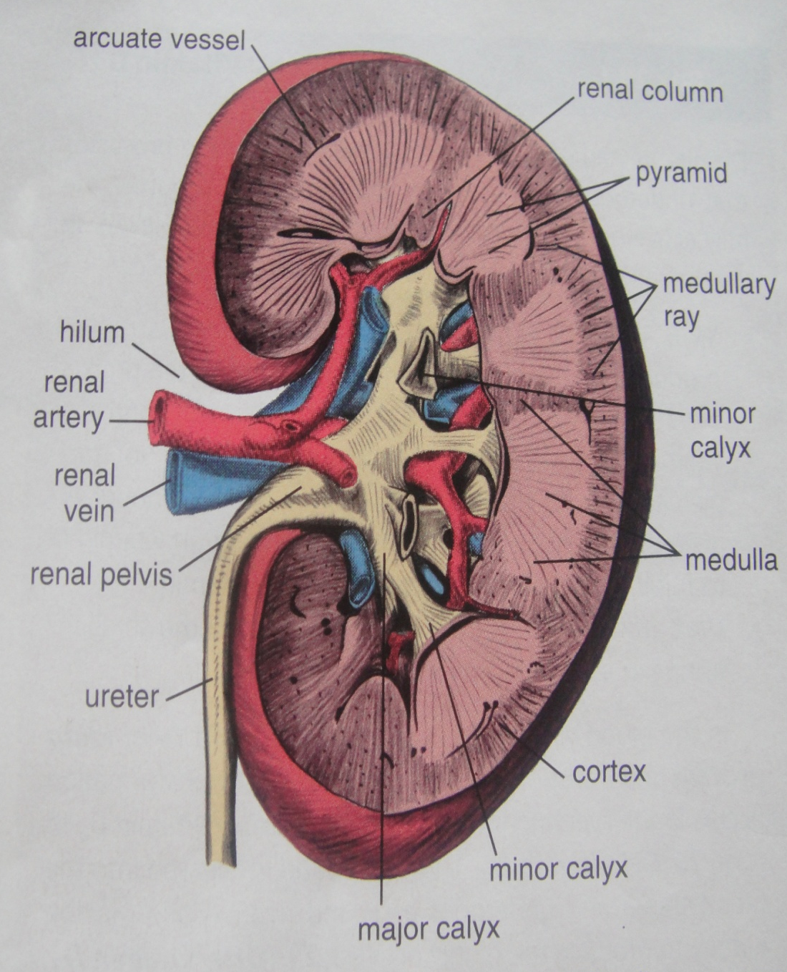
Hemisection of Kidney
Hilum: Renal artery , vein
Renal pelvis –major calyx
-minor calyx
Medulla: -Pyramid
-Renal columns
Cortex :Medullary rays
Notes:
Lobe of kidney is renal pyramid with its overlying cortex and part of its laterally associated renal column and lobule is defined as medullary ray with its laterally asso cortical tissue

Slide 6
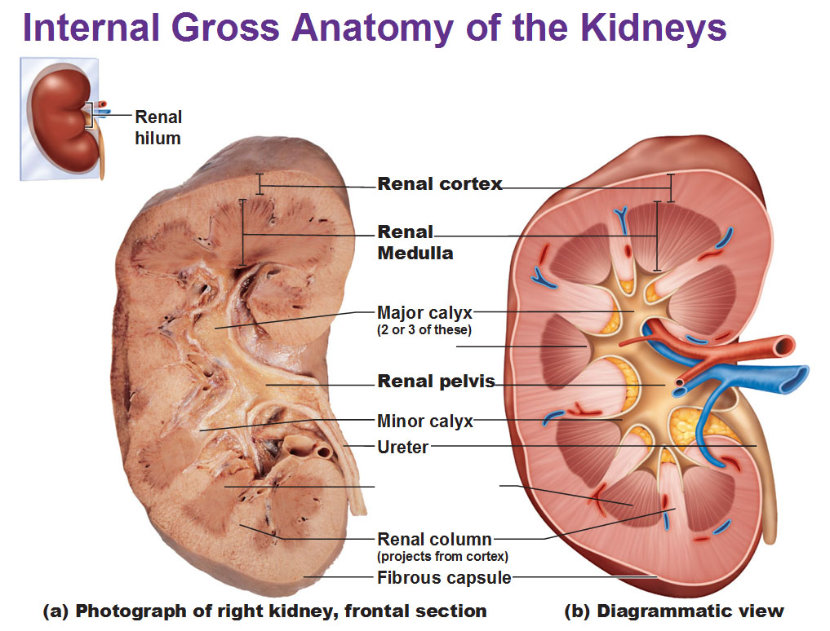

Slide 7
LOBES AND LOBULES
Each kidney lobe consists of a medullary pyramid and its associated cortex.
A renal lobule is defined as a portion of the kidney containing those Nephrons that are drained by a common collecting duct.

Slide 8
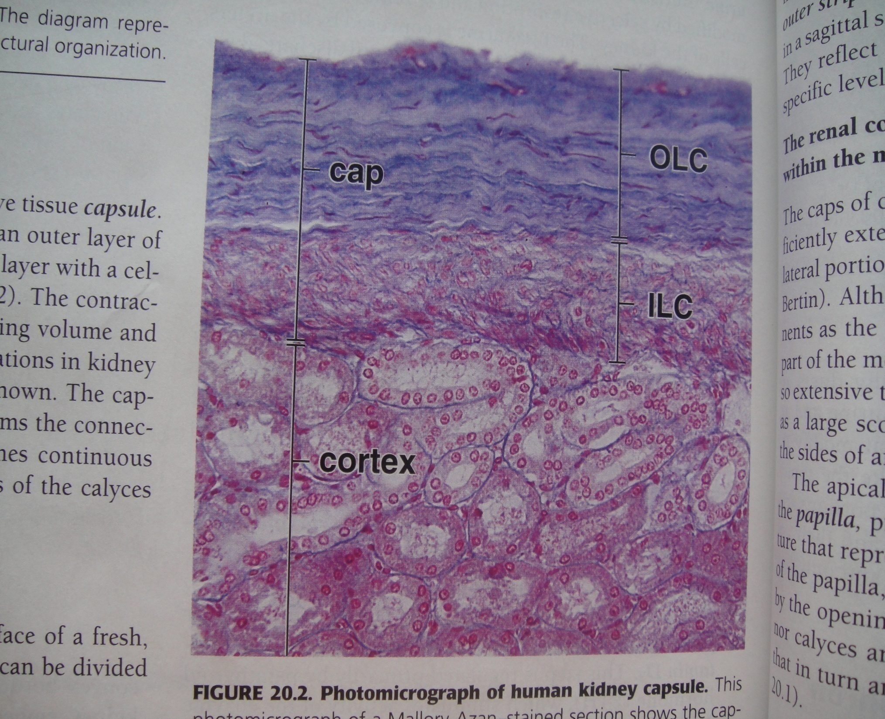
Capsule:
Outer layer
Fibroblasts
collagen fibers
Inner layer
myofibroblasts

Slide 9
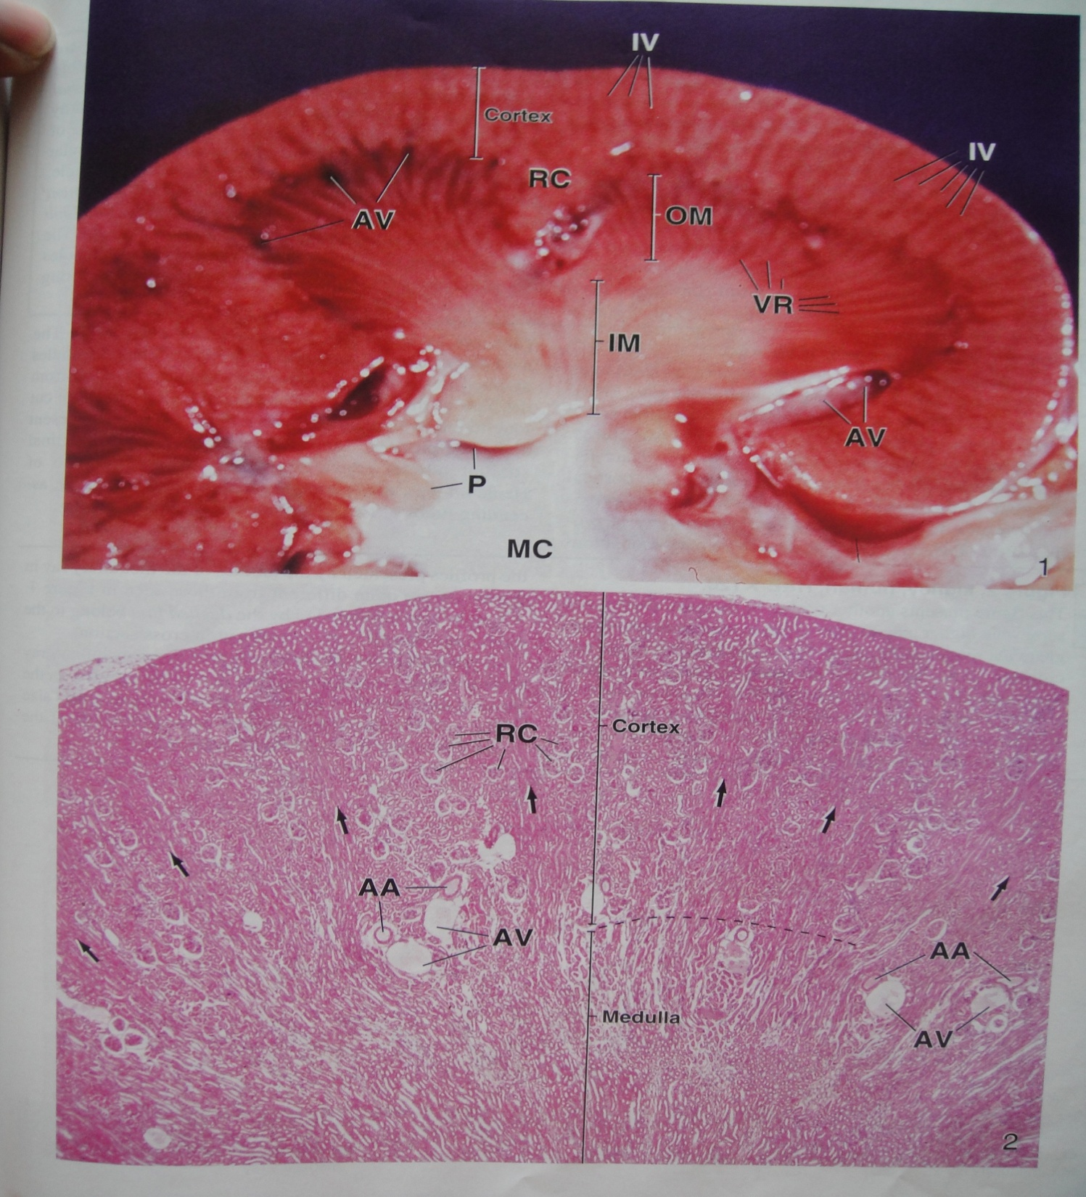
Cut Section Through Hilum
AV-arcuate veins
VR-vasa recta
RC-renal columns
IV-interlobular vessels
H&E-Cortex & Medulla

Slide 10
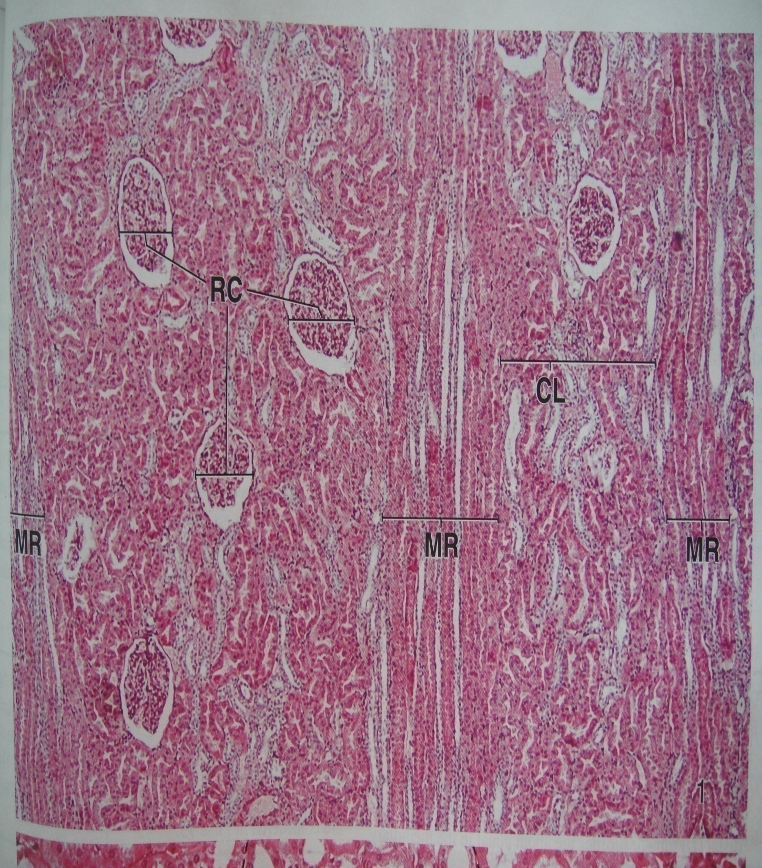
Renal Cortex -H&E
Medullary Rays of Ferrein
Cortical Labyrinth

Slide 12
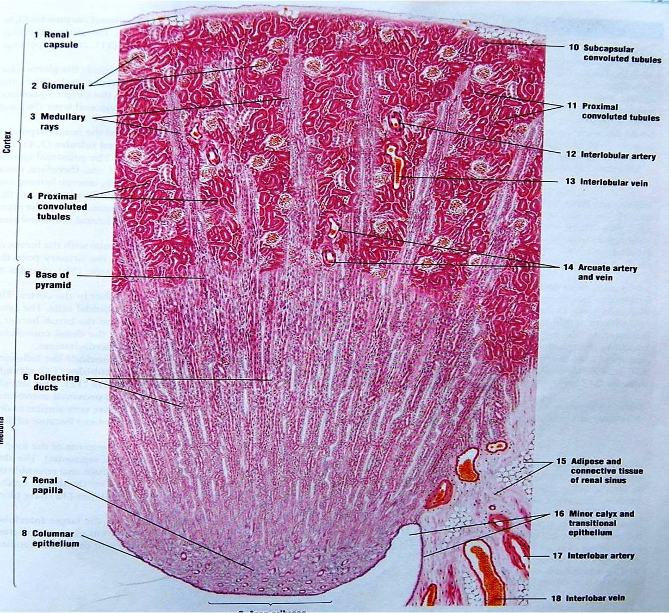
Medulla:
Pyramids
8-12

Slide 13
Medulla in transverse section

Slide 14
Blood supply of kidney

Slide 16
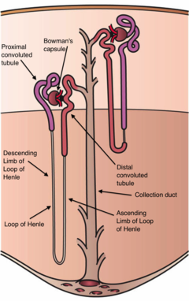
Uriniferous Tubule:
Nephron+Collecting duct
1 – 3 millions of uriniferous tubules.
Nephron- structural and functional unit of kidney
Parts :
Renal Corpuscle -300 micro m.
Renal Tubule -5to7 cm.
1-PCT
2-Loop of Henle
3- DCT
Types-
1-Subcapsular
2-Juxtamedullary
3-Intermediate

Slide 17
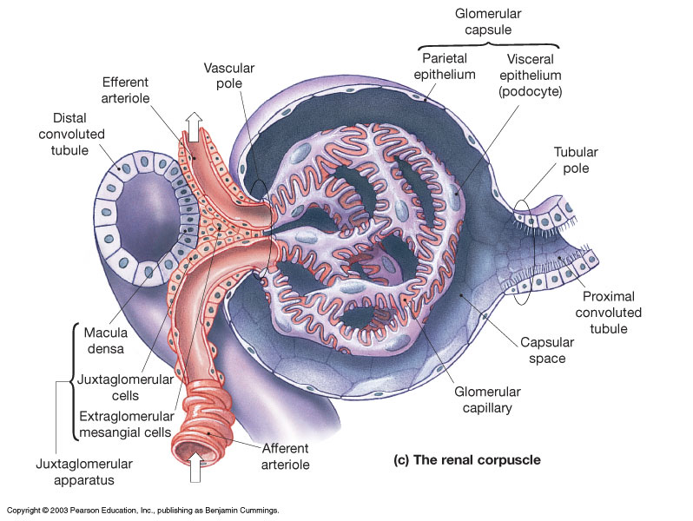
Renal Corpuscle:
It is also called MALPIGHIAN CORPUSCLE
It consist of :
Bowman’s capsule
Glomerulus

Slide 18
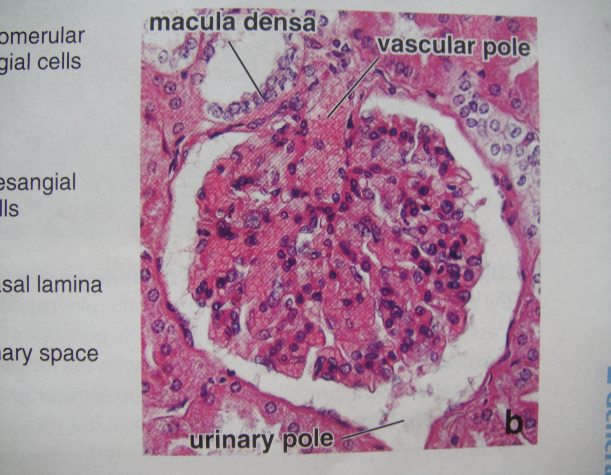
Bowman’s capsule
The bowman’s capsule has :
Outer parietal layer
Inner visceral layer
The space between the parietal and visceral layer is the Urinary space (bowman’s space)
Notes:
Parietal layer is lined by simple squamous epithelium and visceral is lined by podocytes
Urinary space receives the ultra filterate of blood

Slide 20
At the urinary pole the two layers is continuous with the lumen of proximal convoluted tubules
The squamous epithelium of parietal layer at this pole is continues with the cuboidal epithelium of the PCT
The Glomerulus is the tuft of capillaries fed by the afferent arteriole and drained by an efferent arteriole
Notes:
These arteriole are present at vascular pole of the renal corpuscle

Slide 21
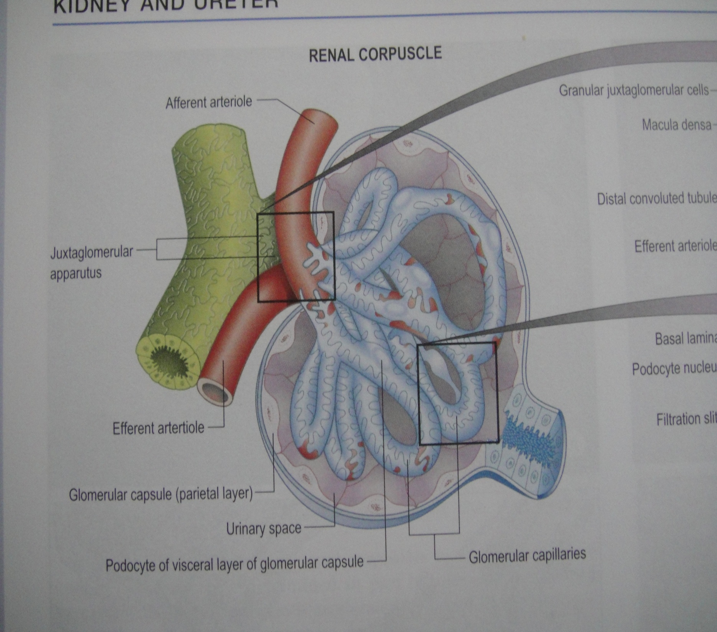

Slide 22
The visceral epithelium is closely related to the endothelium lining of capillaries
The cells of visceral layer become modified and are called as PODOCYTES
The podocytes have many radiating processes, having secondary processes called Foot Processes or Pedicles
These foot processes are separated from each other by narrow intercellular space that are called as Filtration slits
Notes:
The foot processes of neighbouring podocyte interdigitate with each other . The gap of filtration slit is occupied with a thin membrane called as filtration slit membrane or slit membrane

Slide 23
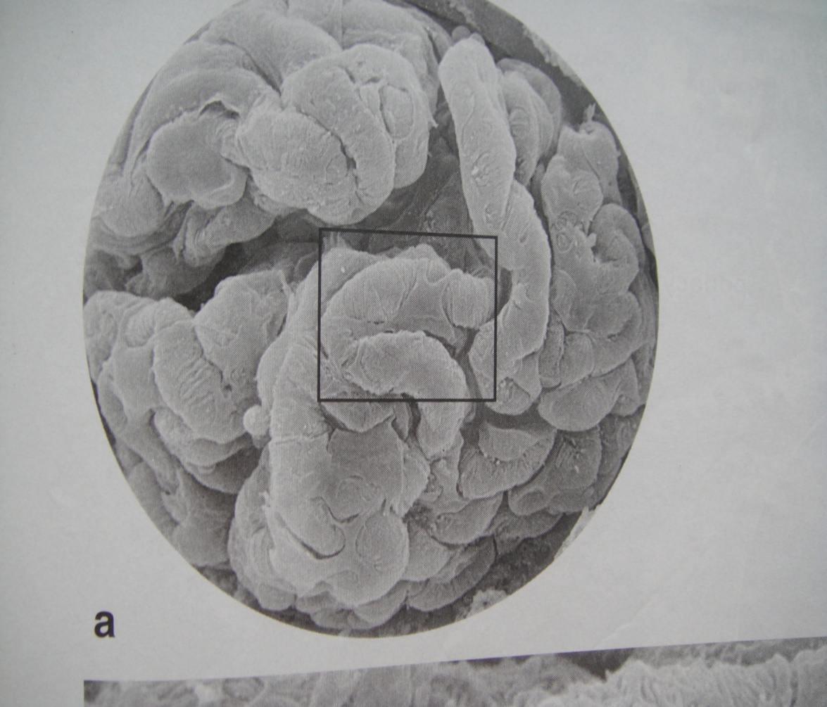
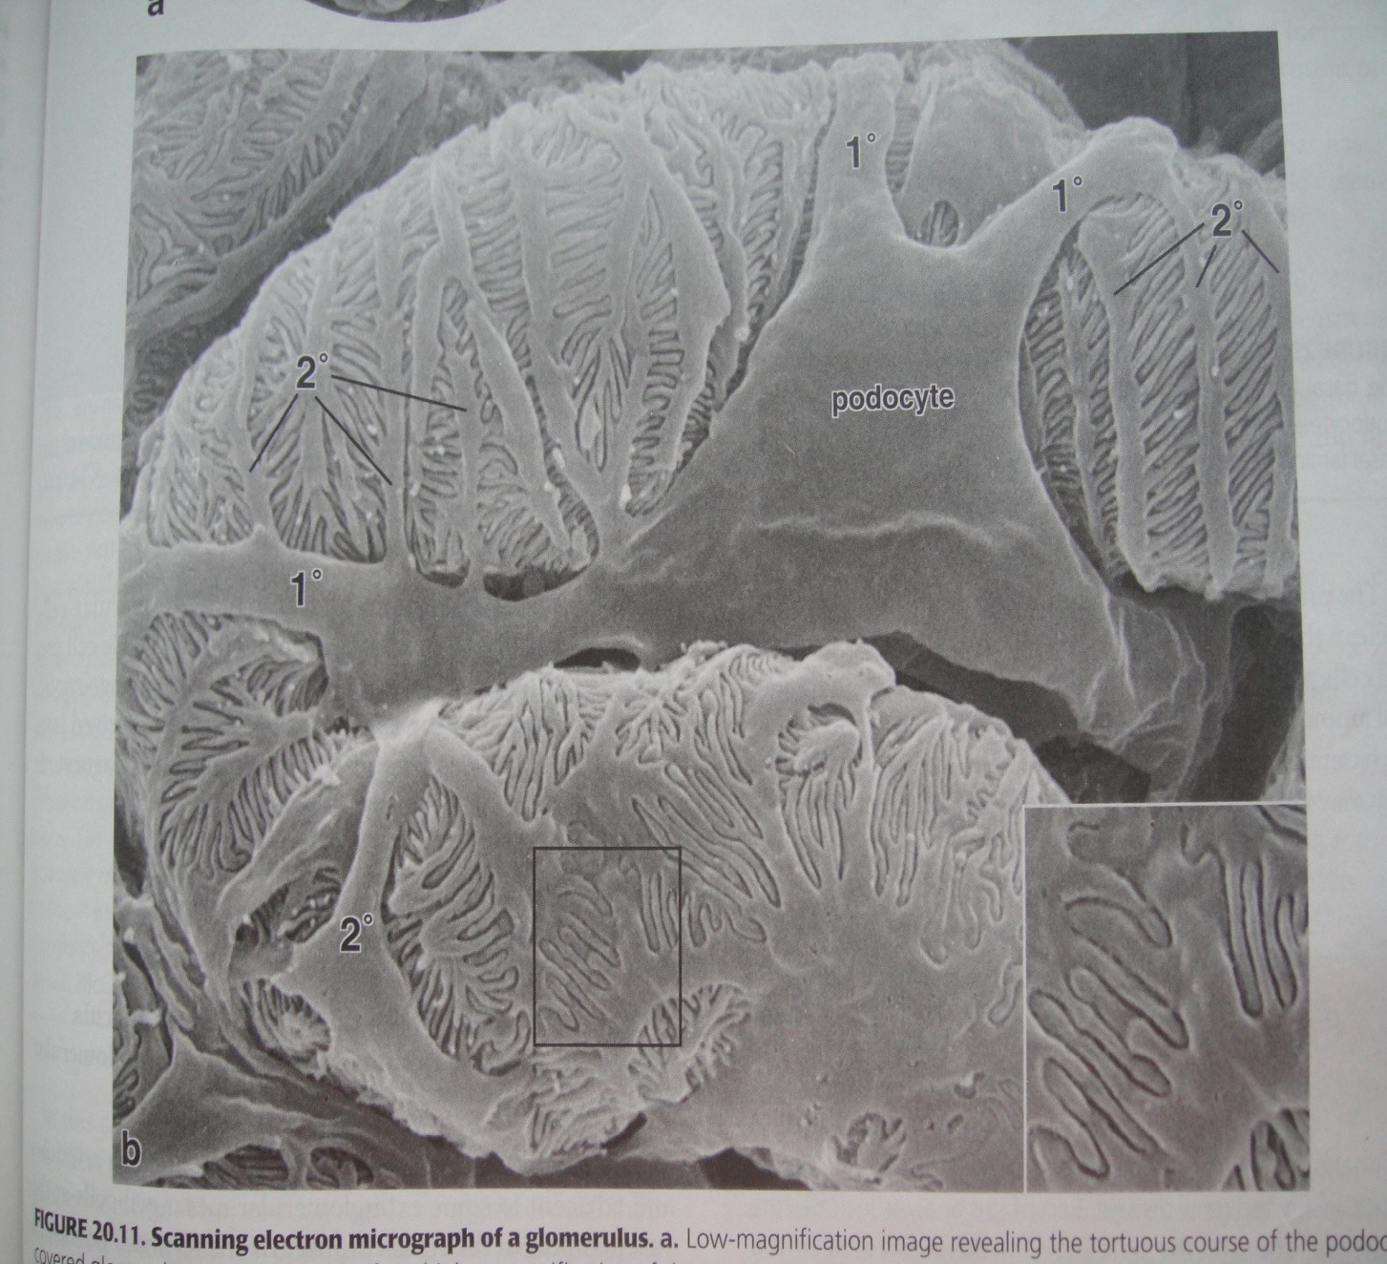
Podocytes:
Podocyte

Slide 24
Filtration barrier
The endothelial cell layer and podocytes cell layer share a common basal lamina.
The foot processes of podocytes are closely applied to common basal lamina
The barrier is made up of :
Fenestrated endothelium
Glomerular basement membrane
Filtration slit membrane

Slide 25
Fenestrated endothelium
The pore of capillary are of 70-90nm in diameter
These pores are not spanned by diaphragm
Allow passage of molecule up to 70,000 molecular weight
Notes:
Has AQP1 channel for fast filtration of water through endothelium

Slide 26
Glomerular basement membrane
Consist of fused basal lamina of endothelium and visceral layer of bowman’s capsule
Made up of type 4 and 18 collagen , proteoglycan , glycoproteins
Major unit of barrier and retains the plasma protien from leaking out

Slide 27
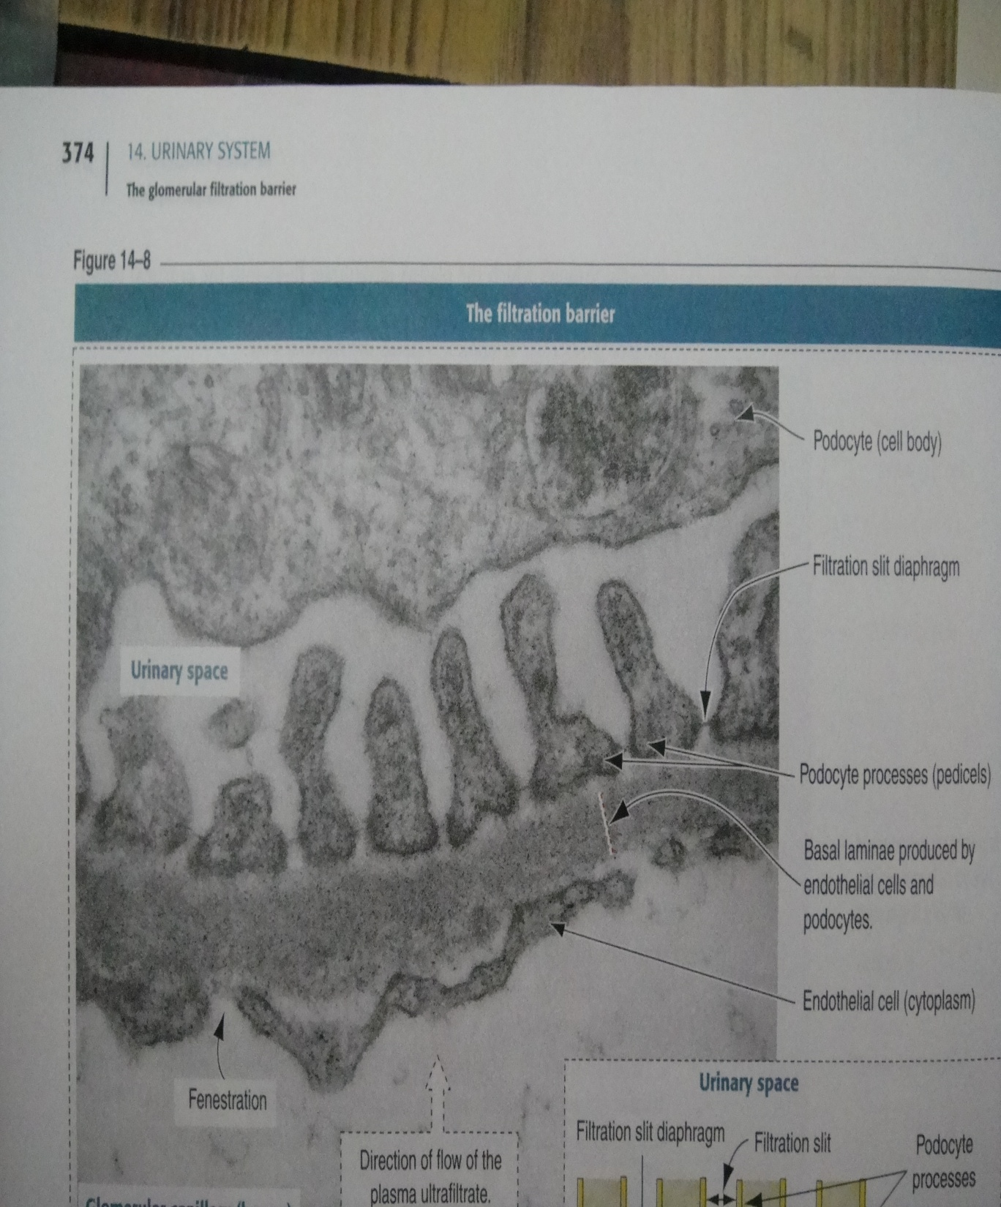

Slide 28
Filtration slit membrane (diaphragm)
Spans between the adjacent podocytes
25nm in width
Formed by transmembrane protein called Nephrin
Protein emerge from the opposite foot processes and forms central density
Membrane has small pores which prevents the passage of albumin and large molecule

Slide 30
Filtration Mechanism

Slide 31
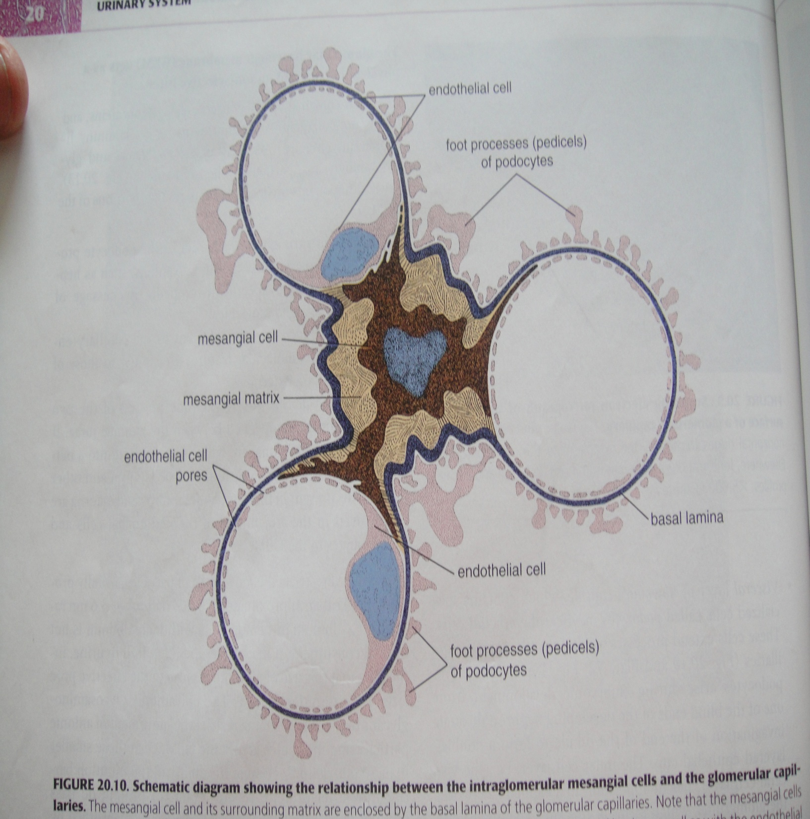
Mesangial cells
The capillaries of Glomerulus are held together by mesangium
Mesangium is connective tissue consisting of :
Mesangial cells in extracellular matrix
Notes:
Mesangial cells correspond to pericyte and may enclosed by basal lamina of glomerular capillaries

Slide 32
Juxtaglomerular apparatus
This is apparatus present near the vascular pole of renal corpuscle
Help in maintaining blood pressure
Constitute of :
Macula densa
Juxtaglomerular cells
Extra Mesangial cells

Slide 34
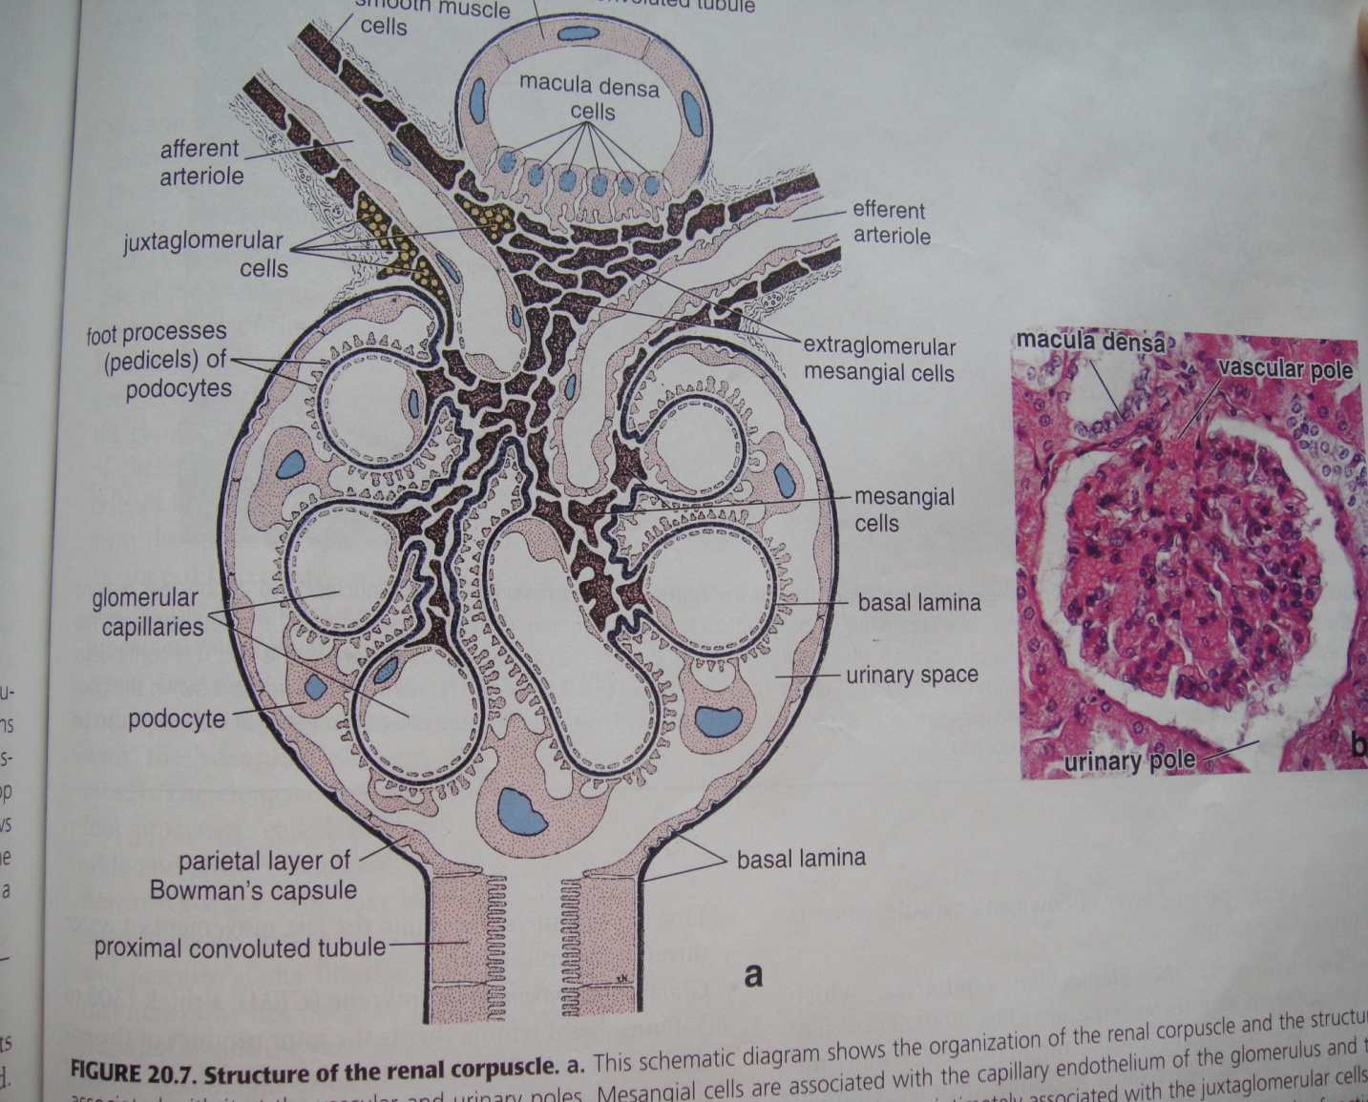
Juxtaglomerular Apparatus

Slide 35
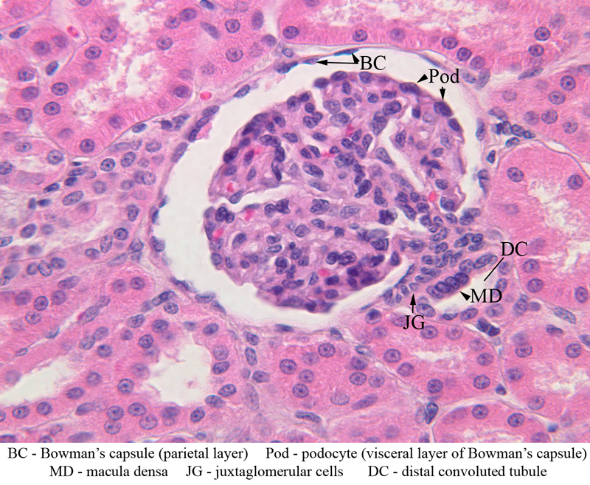
Macula densa
Specialised cells in the beginning of DCT
Adjacent to afferent and efferent arteriole at vascular pole
Cells are narrow , tall columnar and crowded together
Notes:
Have capability to sense a low sodium conc in urine in dct and helps in release renin

Slide 36
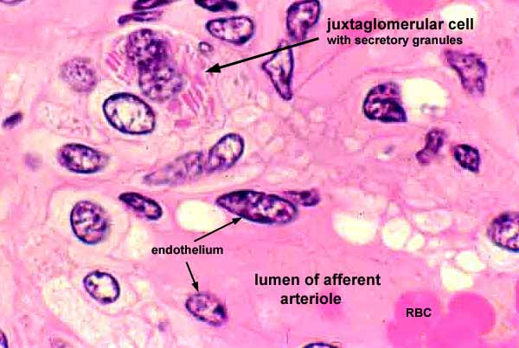
JUXTA GLOMERULAR CELLS
Present adjacent to macula densa
modification of Smooth muscle cells in tunica media of afferent arteriole
Large in size
Contains Secretory granules and no myofilaments
Notes:
Smooth muscle cells ,contain Secretory granules and no myofilaments

Slide 37
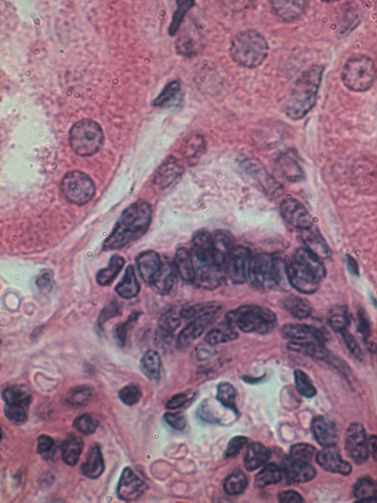
EXTRA GLOMERULAR MESENGIAL CELLS
Form a cushion of cells between afferent, efferent arteriole and macula densa.
These cells have receptors for angiotensin II and may regulate the GFR.

Slide 38
LOBES AND LOBULES
Each kidney lobe consists of a medullary pyramid and its associated cortex.
A renal lobule is defined as a portion of the kidney containing those Nephrons that are drained by a common collecting duct.

Slide 39
Renal Cortex -H&E
Medullary Rays of Ferrein
Cortical Labyrinth

Slide 40
Medulla:
Pyramids
8-12
Outer medulla
Inner medulla

Slide 41
Medulla in transverse section

Slide 42
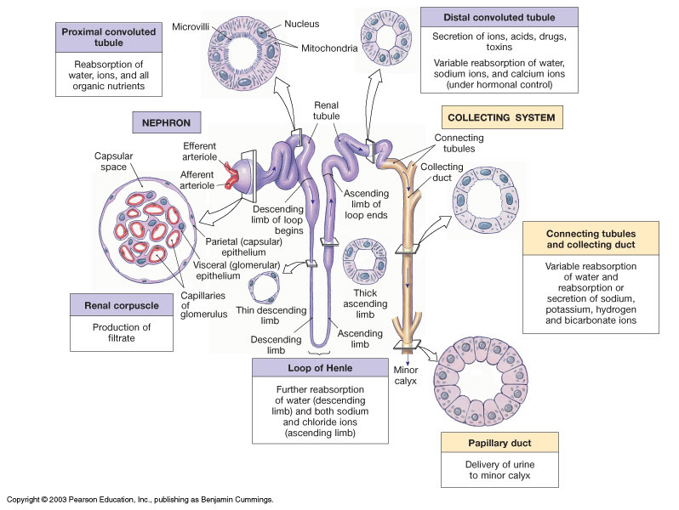

Slide 43
Proximal convoluted tubule
Starts from urinary pole of renal corpuscle to thick portion of Descending limb of Henle
60um in diameter
Complexly coiled
Double length then DCT
Only present in cortex

Slide 44
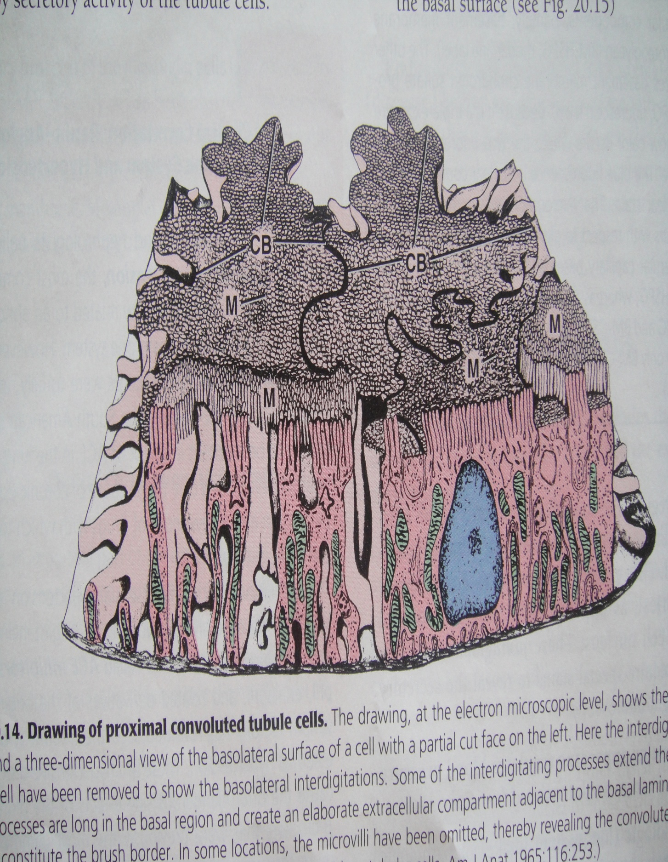
Lined by : simple cuboidal or low columnar epithelium
Brush border due to tall microvilli
Uneven lumen
Nuclei is rounded and centrally placed
Basal part shows striation due to mitochondria

Slide 45
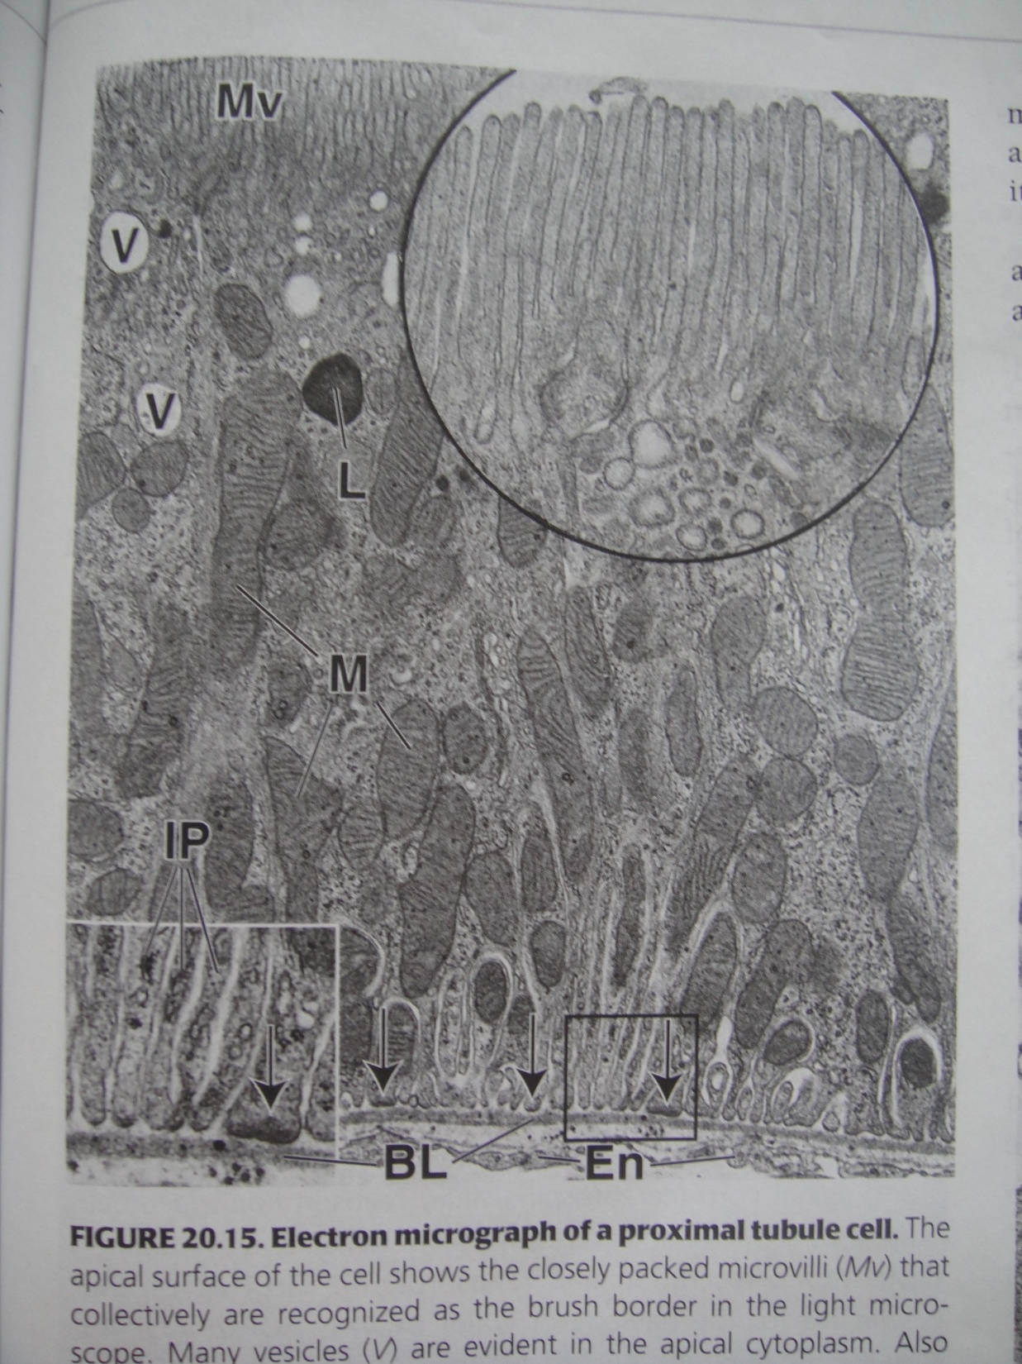
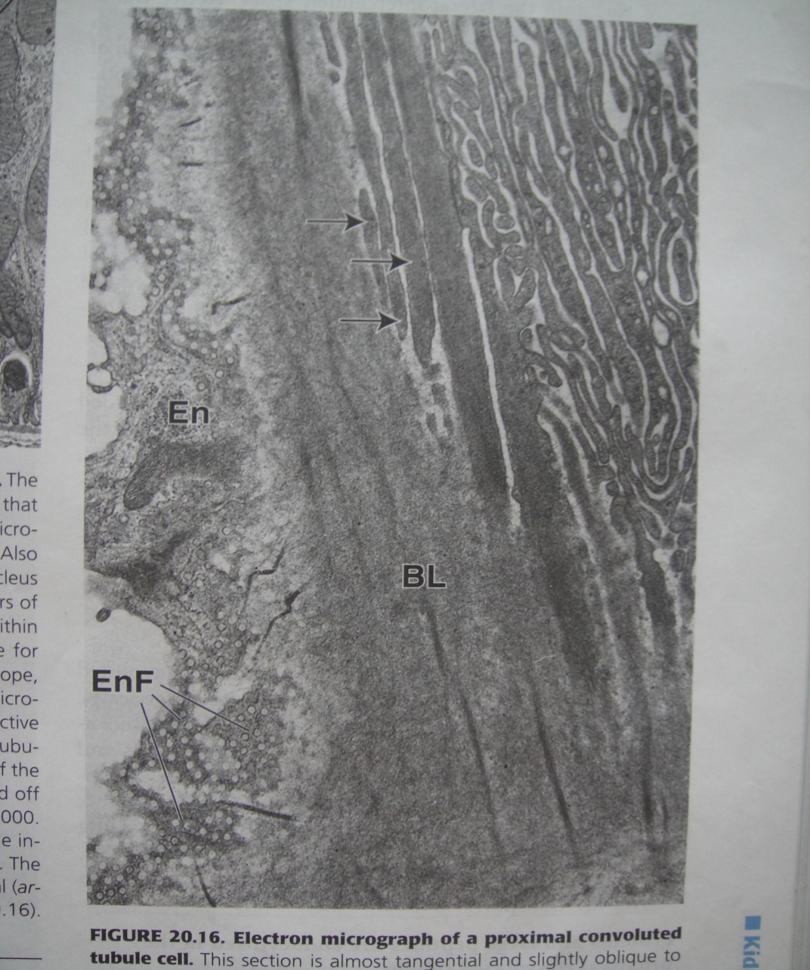
Electron Micrograph of PCT

Slide 46
Proximal convoluted tubule

Slide 47
Loop of henle
PCT continues downwards into medullary ray and medulla as loop of Henle.
Consist of descending limb, hairpin turn and ascending limb

Slide 48
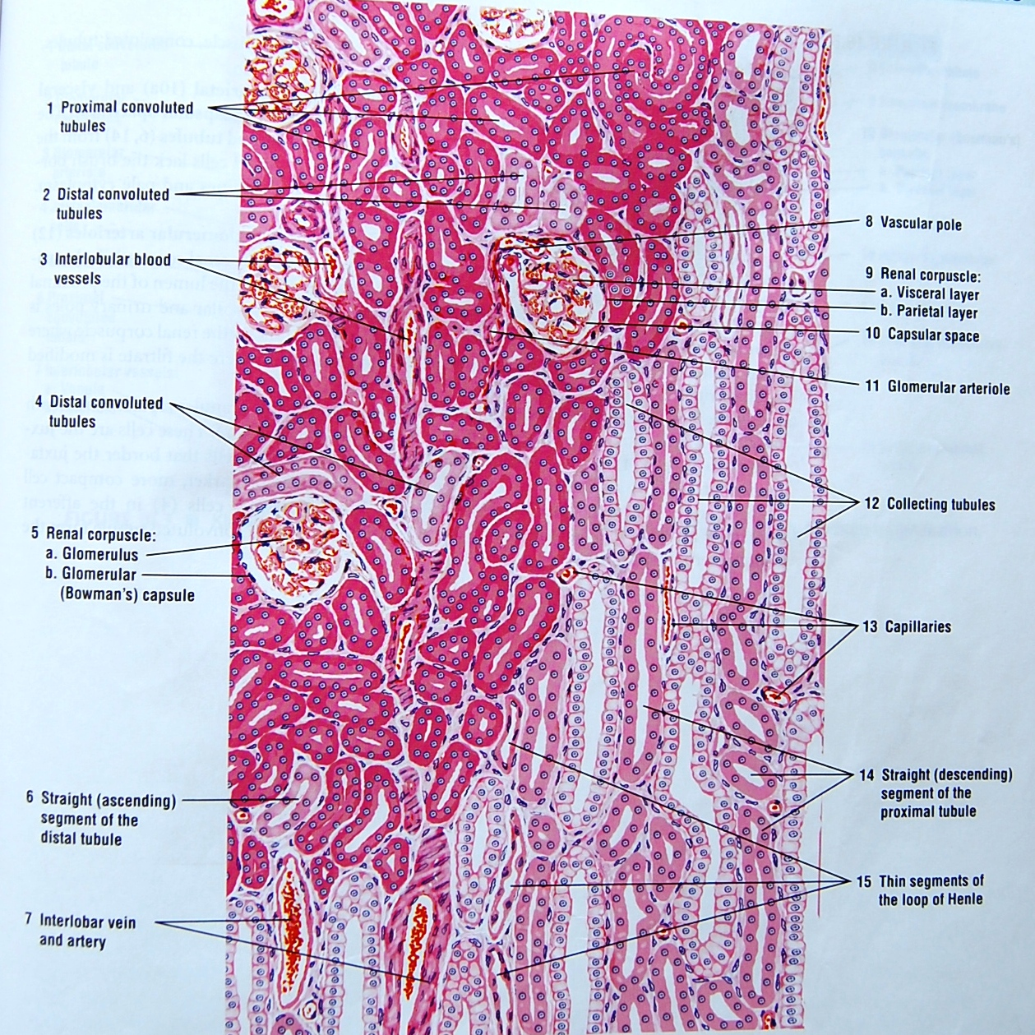
Loop of henle
Ascending and descending thin limbs are 15 um in diameter
Lined by squamous epithelium with few microvilli

Slide 49
Cytoplasm is pale staining and nuclei bulges into small lumen
Thin limb resembles venules

Slide 51
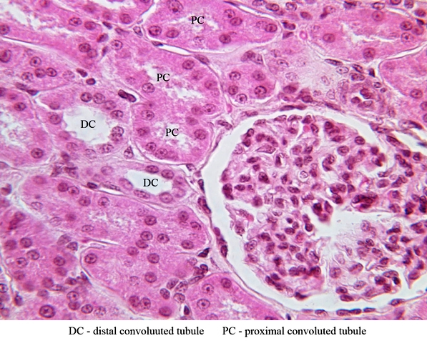
Distal convoluted tubule
Half the length of PCT
Diameter is 15-30um
Lined by low cuboidal epithelium
Cytoplasm stains light eosinophilic
Brush border not present
Large regular lumen

Slide 52
Collecting tubules
Begins in cortex , proceed to medullary ray , joins larger tubules called as collecting ducts.
Duct in medulla runs towards the apex of pyramid and join each other to form DUCT OF BELLINI.

Slide 53
Tubules are of 40um in diameter
Duct are much wider
Tubules are lined by cuboidal epithelium
Ducts by columnar
Lined by two types of cells.
Cells stain lightly eosinophilic
Cell outline is clear

Slide 54
PCT
DCT
Diameter is 45-60um
Lining cells are pyramidal or columnar
Brush border
Lumen irregular , narrow, star shaped
Cytoplasm is deeply eosinophilic
Cell outline not clear
Nuclei are large , spherical
Double the length
Diameter is 25-50um
Lining cells are cuboidal
No brush border
Lumen regular and large
Cytoplasm stains lightly eosinophilic
Cell outline clear
Nuclei are small and spherical
Shorter in length

Slide 55
Ureter
Star shaped lumen
25-35cm length
Conducts urine from kidney to bladder
Layers:
Mucosa
Muscle layer
Adventitia

Slide 56
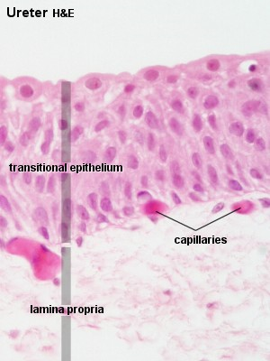
Mucosa :
Transitional epithelium
4-5cell thick
Lamina propria wide and made up of loose connective tissue
Blood vessels and lymphatics are present

Slide 57
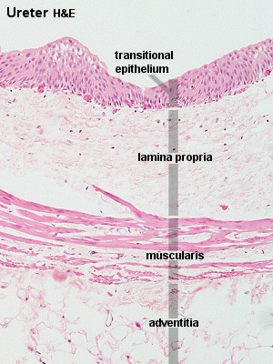
Muscle layer
Consist of smooth muscle :
Inner longitudinal
Outer circular
In middle and lower part , a third outer longitudinal is also present

Slide 58
Adventitia
The outermost layer
Made of loose connective tissue
Contains blood vessels , fat and nerves

Slide 59
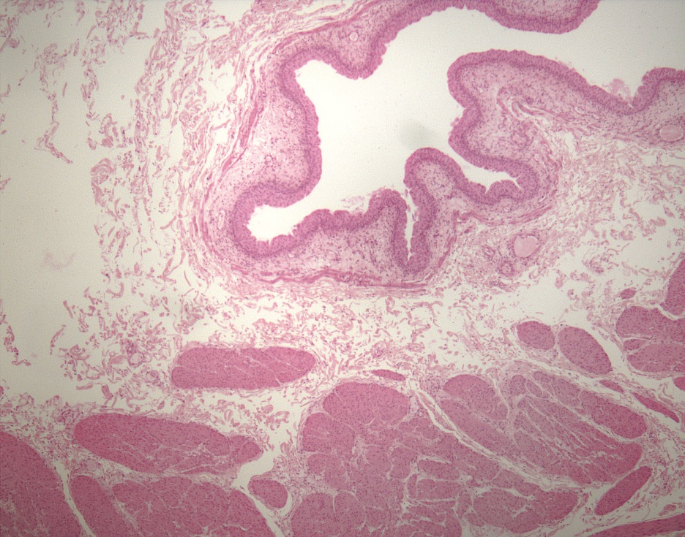
Urinary bladder
Layers in wall of urinary bladder are:
Mucosa
Muscle layer
Serosa/ adventitia

Slide 60
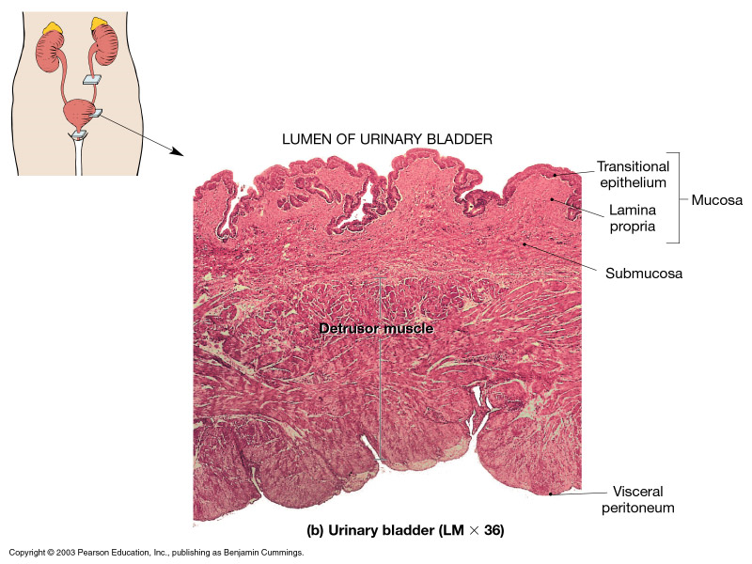
Mucosa
Transitional epithelium
Lamina propria
Empty bladder shows many mucosal folds
Epithelium increases in thickness up 8 cell layer

Slide 61
Superficial cell layer takes dark eosinophillic stain due to the presence of plaques
Full bladder the epithelium becomes thin to 3-4 cell layers
Lamina propria is made of moderately dense connective tissue
Notes:
Plaques are modified areas of plasma membrane , they are rigid and thicker than rest of apical plasma membrane , they give attachment to actin filament on their inner surface

Slide 62
Transitional epithelium

Slide 63
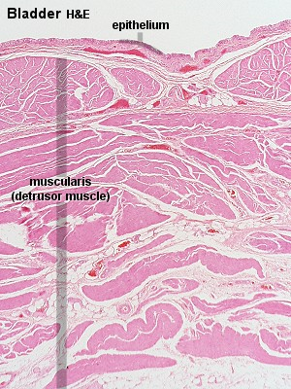
Muscle layer
Smooth muscle
Fibres run in all direction
Has loose connective tissue between the muscle
Three coats:
Transverse
Longitudinal
Oblique
Notes:
Difficult to differentiate

Slide 64
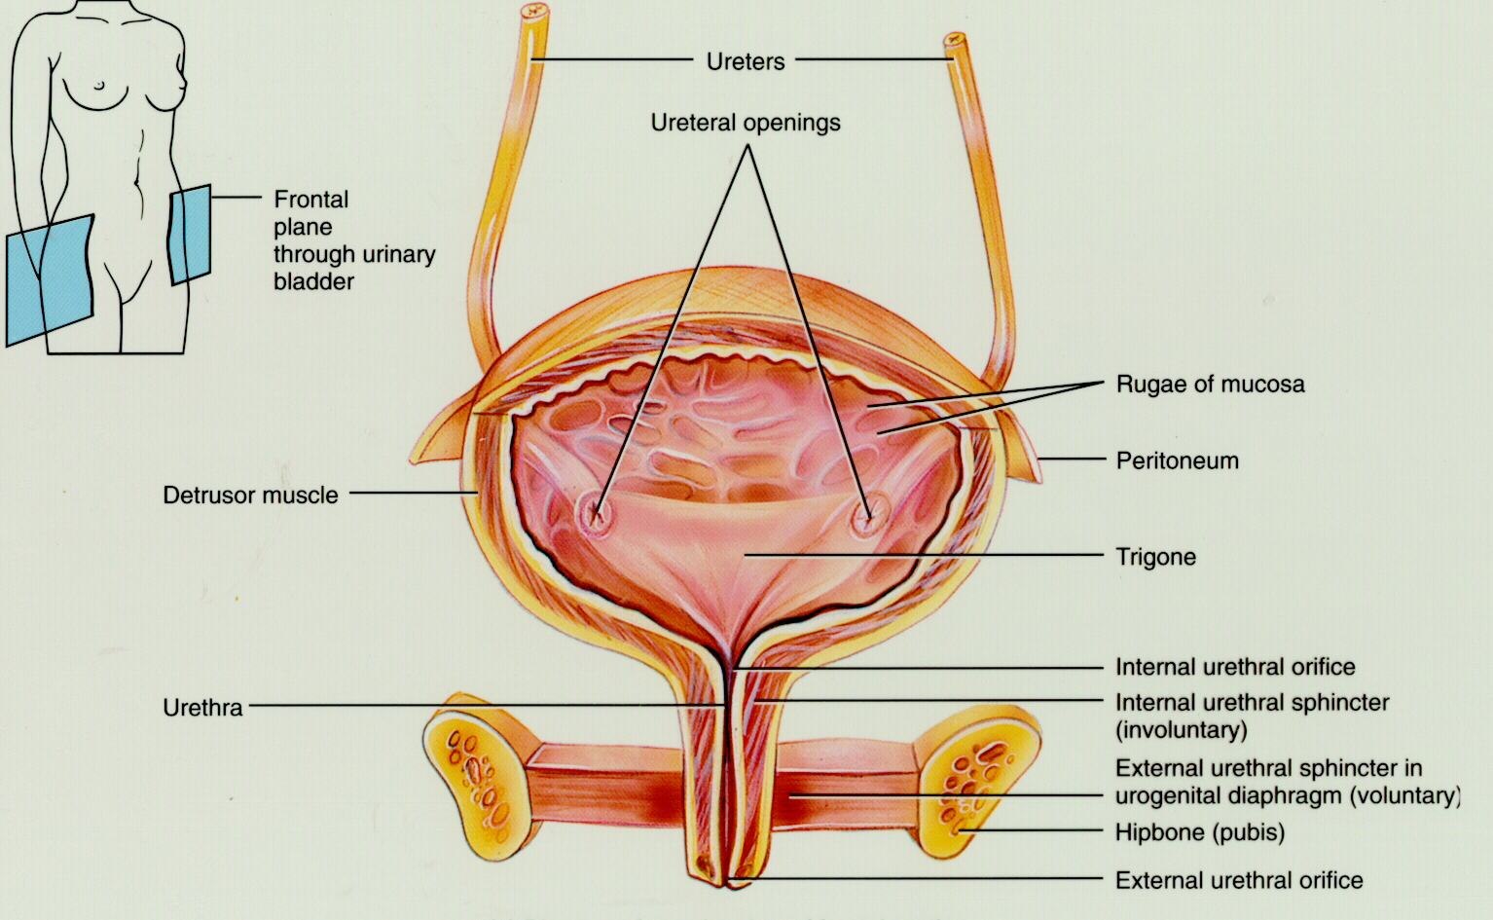
In trigone the mucosa is thin and directly applied to muscle layer

Slide 65
Serosa / adventitia
Superior surface of bladder is covered by serosa
All other surface covered by adventitia

Slide 66
Urethra
Male urethra is long and has prostatic, membranous and penile part
Female urethra is short
Layers:
Muscosa
Submucosa
Muscle layer

Slide 67
Mucosa :
Transitional epithelium
In middle pseudostratified columnar epithelium
Near external opening stratified squamous epithelium

Slide 68
Submucosa consist of
loose connective tissue
Contains venous plexus
Elastic fibres
Muscle layer :
Inner longitudinal
Outer circular
At terminal end urethra is surrounded by skeletal muscle layer
Notes:
Acts as external urethral sphincter

Slide 69
THANK YOU !

