Slide 1
Q & A

Slide 2
1
1. A 61-year-old man had a myocardial infarction 1 year ago and now has marked congestive heart failure that reduces his ability to ambulate. Over the past 24 hours, he has developed right-sided chest pain. On auscultation, there are lower lobe rales. He is afebrile, his pulse is 70/min, his respirations are 27/min and shallow, and his blood pressure is 130/85 mm Hg. His chest CT scan is shown in the figure. Which of the following clinical disorders is most likely to precede the appearance of the lesion shown?
A Chronic obstructive pulmonary disease
B HIV infection
C Nonbacterial thrombotic endocarditis
D Deep vein thrombosis
E Polyarteritis nodosa
F Silicosis

Slide 3
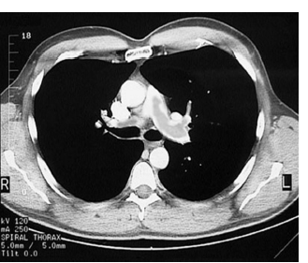

Slide 4
2
2. A clinical study is performed that includes patients who are hospitalized for more than 2 weeks and who were bedridden for more than 90% of that time. These patients undergo Doppler venous ultrasound examination of the lower extremities, blood gas testing, and radiographic pulmonary ventilation and perfusion scanning. A cohort of patients is found who have abnormal ultrasound results suggestive of thrombosis, blood gas parameters with a slightly lower Po2, and small pulmonary perfusion defects. Which of the following symptoms and signs are most likely to be seen in this cohort of patients?
A Dyspnea
B Hemoptysis
C Palpitations
D Pleuritic pain
E Orthopnea
F No symptoms

Slide 5
3
3. A 68-year-old woman had a cerebral infarction and was hospitalized for 3 weeks. Her condition improved, and she was able to get up and move about with assistance. A few minutes after walking to the bathroom, she experienced sudden onset of severe dyspnea with chest pain and diaphoresis. Despite resuscitative measures, she died 30 minutes later. The major autopsy finding is shown in the figure. Which of the following is the most likely mechanism for sudden death in this patient?
A Bronchoconstriction
B Compression atelectasis
C Hemorrhagic infarction
D Interstitial edema
E Acute cor pulmonale

Slide 6
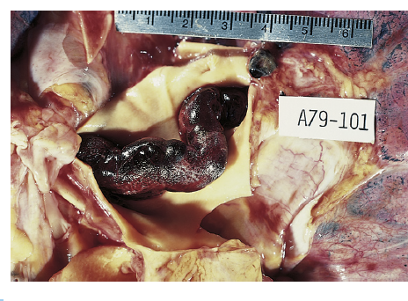

Slide 7
4
4. A 45-year-old man has had progressive dyspnea on exertion with fatigue for the past 2 years. On auscultation of his chest he has a prominent pulmonary component of S2, a systolic murmur of tricuspid insufficiency, and bruits over peripheral lung fields. Jugular venous distension is present to the angle of his jaw when sitting. Laboratory studies show antiphospholipid antibodies. CT angiography shows eccentric occlusions with pulmonary arteries and mosaic attenuation of pulmonary parenchyma. Which of the following is the most likely disease process causing his pulmonary disease?
A Atherosclerosis
B Pneumonitis
C Sarcoidosis
D Thromboembolism
E Vasculitis

Slide 8
5
5. A 75-year-old woman has had worsening lower leg edema and dyspnea for the past 5 years. On physical examination, her temperature is 36.9° C, pulse is 74/min, respirations are 19/min, and blood pressure is 110/75 mm Hg. There is dullness to percussion at the lung bases. A low rumbling heart murmur is present. A chest radiograph shows bilateral pleural effusions. An echocardiogram shows a large (4-cm) atrial septal defect. Which of the following conditions is most likely to be present in this woman?
A Pulmonary hypertension
B Granulomatous inflammation
C Hemorrhagic infarction
D Interstitial fibrosis
E Necrotizing vasculitis

Slide 9
6
6. A 25-year-old woman has had progressive dyspnea and fatigue for the past 2 years. On physical examination, she has pedal edema, jugular venous distention, and hepatomegaly. Lung fields are clear on auscultation. Chest CT scan shows right heart enlargement. Cardiac catheterization is performed, and the pulmonary arterial pressure is increased, without gradients across the pulmonic valve, and no shunts are noted. A transbronchial biopsy is performed, and microscopic examination shows plexiform lesions. A mutation in a gene encoding for which of the following is most likely to cause her pulmonary disease?
A B-type natriuretic peptide (BNP)
B Bone morphogenetic receptor 2 (BMPR2)
C Endothelial nitric oxide synthetase (eNOS)
D Fibrillin-1
E Lysyl hydroxylase
F Renin

Slide 10
7
7. A 29-year-old man who has had no major illnesses experiences acute onset of hemoptysis. On physical examination, he has a temperature of 37° C, pulse of 83/min, respirations of 28/min, and blood pressure of 150/95 mm Hg. A chest radiograph shows bilateral fluffy infiltrates. A transbronchial lung biopsy on microscopic examination shows focal necrosis of alveolar walls associated with prominent intra-alveolar hemorrhage. Two days later, he has oliguria. The serum creatinine level is 2.9 mg/dL, and urea nitrogen is 31 mg/dL. Which of the following antibodies is most likely involved in the pathogenesis of his condition?
A Anti–DNA topoisomerase I antibody
B Anti–glomerular basement membrane antibody
C Antimitochondrial antibody
D Anti–neutrophil cytoplasmic antibody
E Antinuclear antibody

Slide 11
8
8. A 42-year-old man has had chronic sinusitis for 7 months. He now has malaise and a mild fever that have persisted for 3 weeks. On physical examination, his temperature is 37.9° C. On auscultation, a few crackles are heard over the lungs. Laboratory studies show serum urea nitrogen of 35 mg/dL; creatinine, 4.3 mg/dL; ALT, 167 U/L; AST, 154 U/L; and total bilirubin, 1.1 mg/dL. A chest radiograph shows scattered 1-cm pulmonary nodules. A transbronchial lung biopsy is performed, and microscopic examination shows necrotizing granulomatous capillaritis, a poorly formed granuloma, and intra-alveolar hemorrhage. Urinalysis shows RBCs with RBC casts. Autoantibodies to which of the following are most likely to be present in this man?
A DNA topoisomerase I (Scl-70)
B Double-stranded DNA (dsDNA)
C Glomerular basement membrane (GBM)
D Serine proteinase 3 (PR3-ANCA)
E Thermoactinomyces vulgaris

Slide 12
THANK YOU.

