Slide 1

THYROID HORMONE & ANTI-THYROID DRUGS
Dr. K.K. Mishra
Assistant Professor
S.K.M.C.H. Muzaffarpur

Slide 2
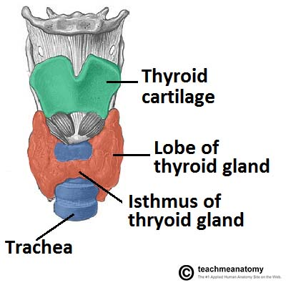
Anatomy ot thyroid gland

Slide 3
Thyroid gland comprises of two type of cells:
1.Thyroid follicles- secrete T4 (thyroxine) & T3 (tri iodo thyronine) .
both hormone collectively called thyroid hormone
2. interfollicular C cells – secretes calcitonin which helps in calcium metabolism.

Slide 4
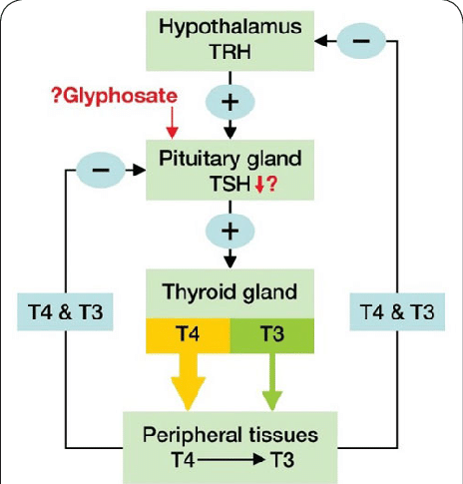
THYROID HORMONE:- regulation of hormone synthesis

Slide 5
SYNTHESIS OF THYROXINE:-
SYNTHESIS OF HORMONE:-
both T4 & T3 are iodine containing derivative of thyronine formed by tyrosine.
Chemically T4 is tetra iodo thyronine & T3 is tri iodo thyronine.
thyroid hormone circulate after bound to plasma proteins like
1. thyroid binding globulin(TBG)
2. thyroxine binding pre albumin
3. albumin
only free hormone is available for action.

Slide 6
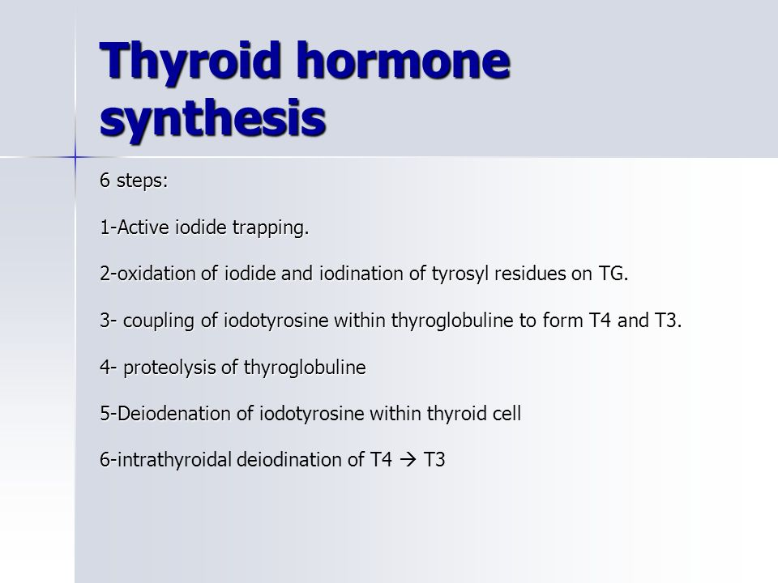

Slide 7
RELATION BETWEEN T4 & T3-
1. Secretion of T4 is more than T3.
2. T4 is more tightly bound with plasma protein while T3 is more tightly bound with nuclear receptors.
3.T4 is main circulatory form while T3 is the active form.
4. T3 is more potent and faster acting while T4 is less potent and slow acting.
5.Approximately one third of T4 is converted into T3 in peripheral tissue.

Slide 8
ACTION OF THYROID HORMONE:-
most of action of thyroid hormone are mediated through thyroid receptor. So most of action of thyroid hormone carried out by T3 while T4 is major circulatory hormone,
1. growth & development:-
thyroid hormone affect growth of body tissues partly direct action & partly by facilitating the action of growth hormone.
thyroid hormone is critically important for growth of brain. Active neurogenesis takes place during 1st6 month of life. Absence of thyroid hormone during this leads to irreversible brain damage(cretinism).

Slide 9
2. Calorigenic effect:-
thyroid hormone regulate the set point of energy expenditure that is disturbed in patient of hypothyroidism.
3. Cardiovascular effect:-
sensitization of cardiac muscle to catecholamine is increased by thyroid hormone. So hyperthyroidism leads to tachycardia, increase stroke volume, hypertrophy of cardiac muscle, increase pulse pressure & in hypothyroidism vice versa.

Slide 10
4. Metabolic effects:-
carbohydrate metabolism- in hyperthyroidism patient insulin resistance may develop which leads to increase blood glucose level, mainly due to glycogenolysis & gluconeogenesis.
fat metabolism- thyroxine causes lipolysis by facilitating action of catecholamines. There is increased level of fatty acid. Hypocholesterolemia & decrease LDL level is found.
protein metabolism- usual effect is catabolic leading to muscle wasting and weight loss.

Slide 11
5. Reproductive system:-
normal hormone level is important for normal fertility in both male and female. In male hypothyroidism leads to decrease libido, impotence & oligozoospermia. In female there is anovulatory cycle. Correction of hormone leads to regain fertility.
6. Blood formation:-
thyroxine facilititates formation of red blood cells by helping absorption of iron, folic acid & vitaminB12, so deficiency causes anemia. In hyperthyroidism there is normochromic anemia due to increse RBC turnover.

Slide 12
7. GIT:-
the gastric peristalsis is increased by thyroid hormone , so there is constipation in hypothyroidism patient & diarrhoea in hyperthyroidism patients.
8. Skeletal muscles:-
in thyrotoxicosis there is weakness, muscle fatigue, increase deep tendon reflex & muscle tremor is found.
9. Renal system:-
increase renal blood flow may lead to increase GFR and polyuria.

Slide 13
PHARMACOKINETICS:-
the absorption after oral administration is good and affected by food. So for complete absorption it should be taken in empty stomach. Thyroxine is concentrated in liver and kidney while tri iodo form is widely distributed in body. Both form metabolised by liver & excreted in bile.
t1/2 T4 of is 6-7 days, while t1/2 of T3 is 1-2 days . Plasma half life of both form is reduced in hyperthyroidism & increased in hypothyroidism.

Slide 14
CLINICAL USES:-
Thyroid hormone is mainly used as supplement in deficiency disease.
1. Cretinism (congenital hypothyroidism)- it is severe form of hypothyroidism found in children due to deficiency of thyroid hormone of any cause. There is physical and mental retardation in affected children. Early correction of hormone level normalises both physical and mental condition. Delayed correction does not correct mental retardation.

Slide 15
this is due to the reason that thyroid hormone is critically required at the time of formation of mylein sheath that occurs in early age. Correction after that period correct the physical growth not correct mental retardation, so earliest diagnosis by screening is important.
recommended dose is 10 to 15 microgram/kg daily for initial treatment which may be titrated to 6 to 8 microgram/day measuring TSH and thyroxine level.

Slide 16
2. Adult hypothyroidism:-
hypothyroidism in adult may be idiopathic, due to iodine deficiency (endemic goitre), exposure to goitrogens (substance that inhibit the formation of thyroid hormone), thyroiditis (hashimoto thyroiditis), thyroidectomy, overdose of radioactive iodine.
dose is 100 to 200 microgram/day. Usual starting dose is 25 microgram/day then increment of 25 microgram every 6week till normal TSH level is achieved.

Slide 17
3. Myxoedema:-
it is severe type of hypothyroidism with peculiar thickening of skin & often associated with coronary artery disease. Treatment is started with 12.5 microgram of levothyroxine /day.
4. Simple or nontoxic goitre:-
Is due to iodine deficiency in food items.in such case thyroid gland is enlarged due excess of TSH. Treatment consist of hormone therapy along with iodine supplemented food.

Slide 18
5. Myxoedema coma:-
although rare but this is medical emergency with high mortality. It results from untreated prolonged hypothyroidism usually in elderly. Patient passes into coma which is accelerated by indiscriminate use of cns depressant like opioid. Clinical symptoms are like unconsciousness, hypothermia, respiratory depression, bradycardia, dry rough skin. Confirmed by raised TSH level.

Slide 19
treatment is mainly supportive. Intravenous levothyroxine is given in loading dose 200 to 300 microgram, followed by 2nd dose 100 microgram after 24 hour.
alternatively liothyronine 10 microgram 8hourly i.v. may be given in some cases till patient become conscious.
(or) in some patient 500 microgram of levothyroxine through nasogastric tube may be given.
Dose of drug is adjusted on the basis of hemodynamic changes, glucocorticoid deficiency and electrolyte imbalance (dilutional hyponatremia ).

Slide 20
6. Nodular goitre:-
Benign nodule of thyroid grow under influence of TSH. In patient with raised level of TSH thyroxine depress TSH level and subsequently size of nodule. If the nodule is of malignant type surgical excision is treatment .
7. Papillary carcinoma:-
papillary carcinoma of thyroid grow under influence of TSH so supression of TSH causes regression of tumour.
8. Refractory anemia:-

Slide 21
Thyroxine in pregnancy:-
in hypothyroid female there is anovulatory cycle so pregnancy is not possible unless hormone level is corrected.
if a hypothyroid patient taking drug become pregnant dose should be increased by 20 to 30% as level of thyroid binding globulin is increased due to estrogen so available free hormone level is reduced.
subclinical hypothyroidism during pregnancy may lead to fetal distress & mild impaired neural development..

Slide 22
TOXICITY OF THYROXINE:-
Depends upon hormone level.
In children restlessness, insomnia, enhanced growth & enhanced bone maturation may occur.
In adults tachycardia, palpitation, nervousness, tremor, agitation, psychosis, diarrhoea, unexplained weight loss, hyperkinesia & heat intolerance are common.
In elderly with preexisting cardiac disease chances of arrythmia, atrial fibrillation, precipitation of angina are common.

Slide 23
THANK YOU

