Slide 1
Chronic Diffuse Interstitial (Restrictive) Diseases
DR. NISHI
Assistant Professor
Department of Pathology
SKMCH, Muzaffarpur

Slide 2
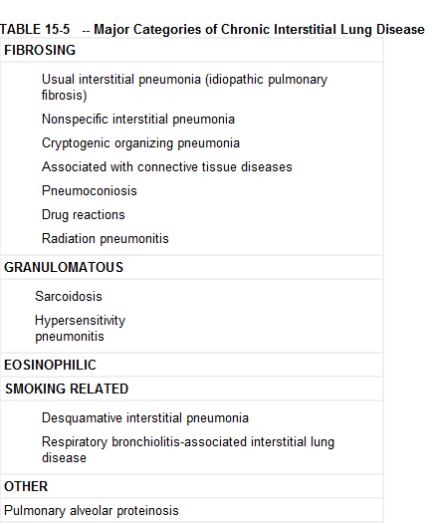
Diffuse restrictive diseases are categorized based on histology and clinical features .

Slide 3
Pneumoconioses
Originally the term pneumoconiosis was coined for the non-neoplastic lung reaction to inhalation of mineral dusts at workplace.
Diseases induced by organic as well as inorganic particulates and chemical fumes and vapours.
Regulations limiting worker’s exposure have resulted in a marked decrease in dust-associated diseases.

Slide 4
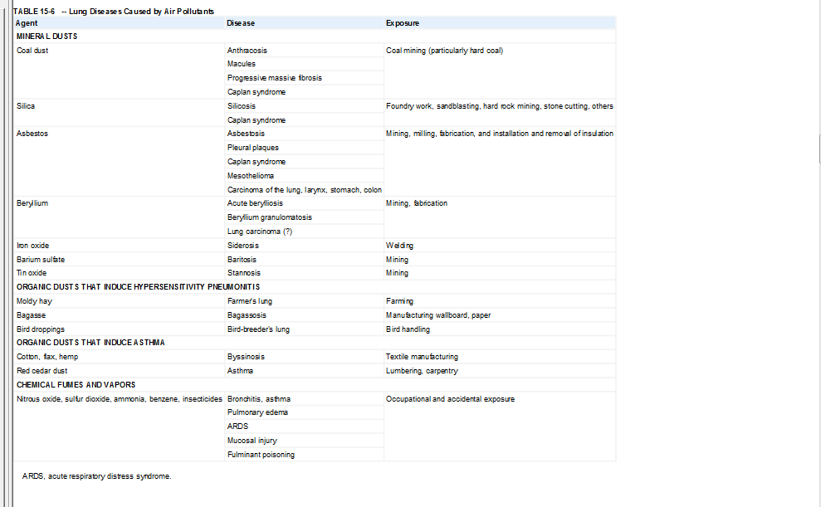
Classification

Slide 5
The pneumoconioses results from well-defined occupational exposure to specific airborne agents.
Particulate air pollution also has deleterious effects on the general population in urban areas.
Increased morbidity (e.g., Asthma incidence) and mortality rates in populations that are exposed to high ambient air particulate levels.

Slide 6
Pathogenesis.
The development of a pneumoconiosis depends on
The amount of dust retained in the lung and airways
The size, shape, and therefore buoyancy of the particles
Particle solubility and physiochemical reactivity; and
The possible additional effects of other irritants (e.g., concomitant tobacco smoking).

Slide 7
The amount of dust retained in the lungs is determined by
The dust concentration in ambient air,
The duration of exposure, and
The effectiveness of clearance mechanisms.
Any influence, that affects the integrity of the mucociliary apparatus significantly predisposes to the accumulation of dust, such as cigarette smoking

Slide 8
The most dangerous particles range from 1 to 5 μm in diameter .
They may reach the terminal small airways and air sacs and settle in their linings.
Under normal conditions there is a small pool of intra-alveolar macrophages
This is expanded by recruitment of more macrophages when dust reaches the alveolar spaces.
The protection provided by phagocytosis of particles can be overwhelmed by a large dust burden by specific chemical interactions of the particles with cells.

Slide 9
The solubility and cytotoxicity of particles are influenced by their size----modify the nature of the pulmonary response.
The smaller the particle ---- more likely to appear in the pulmonary fluids ----- reach toxic levels rapidly, depending on the solubility of the agent.
Smaller particles tend to cause acute lung injury.
Larger particles resist dissolution and so may persist within the lung parenchyma for years-----evoke fibrosing collagenous pneumoconioses----is characteristic of silicosis.
Some of the particles------ may be taken up by epithelial cells or may cross the epithelial cell lining ----interact directly with fibroblasts and interstitial macrophages.

Slide 10
Some particles may reach the lymphatics by direct drainage or within migrating macrophages ---- initiate an immune response to components of the particulates or to self-proteins modified by the particles or both.
This response amplifies the intensity and the duration of the local reaction.
Tobacco smoking worsens the effects of all inhaled mineral dusts
The effects of asbestos are particularly magnified by smoking
The effects of inhaled particles are not confined to the lung alone, since solutes from particles can enter the blood and lung inflammation invokes systemic responses
In general, only a small percentage of exposed people develop occupational respiratory diseases, implying a genetic predisposition to their development.
Genetic variation of serum and erythrocytic proteins---- shown to correlate with susceptibility to developing silicosis, chronic bronchitis, and occupational asthma.
Many of the diseases are quite uncommon.

Slide 11
Coal Workers' Pneumoconiosis
Dust reduction measures in coal mines have drastically reduced the incidence of coal workers' pneumoconiosis (CWP).
The spectrum of lung findings in coal workers is wide
Asymptomatic anthracosis
(2) Simple CWP with little to no pulmonary dysfunction
(3) Complicated CWP, or progressive massive fibrosis (PMF), in which lung function is compromised.
The pathogenesis of complicated CWP, particularly what causes the lesions of simple CWP to progress to PMF, is incompletely understood.
Contaminating silica in the coal dust can favor progressive disease.
Carbon dust itself is the major culprit
Complicated lesions contain much more dust

Slide 12
Morphology.
Anthracosis is the most innocuous coal-induced pulmonary lesion in coal miners
Also seen in urban dwellers and tobacco smokers.
Inhaled carbon pigment is engulfed by alveolar or interstitial macrophages----accumulate in the connective tissue along the lymphatics, including the pleural lymphatics, or in organized lymphoid tissue along the bronchi or in the lung hilus.
Simple CWP is characterized by coal macules (1 to 2 mm in diameter) and the somewhat larger coal nodules.
The coal macule consists of carbon-laden macrophages
The nodule also contains small amounts of a delicate network of collagen fibers.
These lesions are scattered throughout the lung
The upper lobes and upper zones of the lower lobes are more heavily involved.
Are located primarily adjacent to respiratory bronchioles, the site of initial dust accumulation.
In due course dilation of adjacent alveoli occurs, a condition---referred to as centrilobular emphysema.

Slide 13
Complicated CWP (progressive massive fibrosis)
Complicated CWP (progressive massive fibrosis) occurs on a background of simple CWP
Requires many years to develop.
Characterized by intensely blackened scars larger than 2 cm, sometimes up to 10 cm in greatest diameter.
Usually multiple.
Microscopically the lesions consist of dense collagen and pigment.
The center of the lesion is often necrotic due to local ischemia.

Slide 14
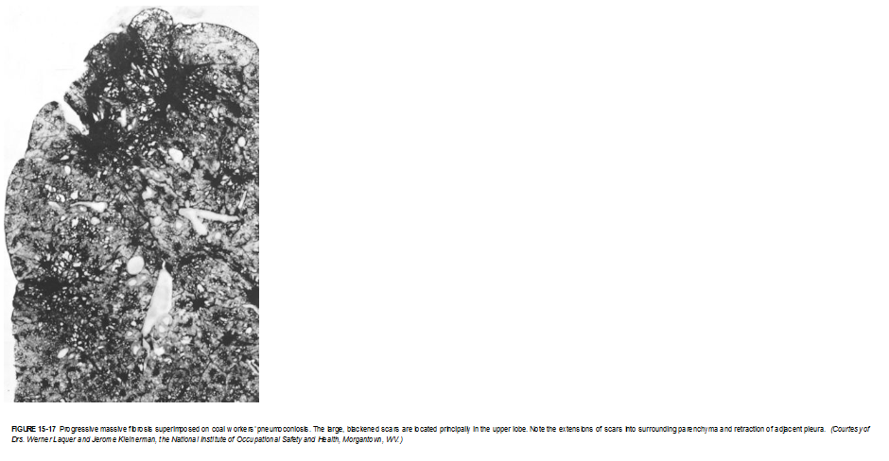

Slide 15
Clinical Course.
CWP is usually a benign disease
Causes little decrement in lung function.
Mild forms of complicated CWP fail to demonstrate abnormalities of lung function.
In a minority of cases (fewer than 10%), PMF develops, leading to increasing pulmonary dysfunction, pulmonary hypertension, and cor pulmonale.
Once PMF develops, it may become progressive even if further exposure to dust is prevented.
Unlike silicosis there is no convincing evidence that coal dust increases susceptibility to tuberculosis.
There is some evidence that exposure to coal dust increases the incidence of chronic bronchitis and emphysema, independent of smoking.
There is no evidence that cwp in the absence of smoking predisposes to cancer.

Slide 16
Silicosis
Silicosis is a lung disease caused by inhalation of crystalline silicon dioxide (silica).
Currently the most prevalent chronic occupational disease in the world,
Silicosis usually presents after decades of exposure as a slowly progressing, nodular, fibrosing pneumoconiosis.
Workers in a large number of occupations are at risk, especially sandblasters and many mine workers.
Heavy exposure over months to a few years can result in acute silicosis, a disorder characterized by the accumulation of abundant lipoproteinaceous material within alveoli (identical morphologically to alveolar proteinosis).

Slide 17
Pathogenesis.
Silica occurs in both crystalline and amorphous forms,
crystalline forms (including quartz, crystobalite, and tridymite) are much more fibrogenic.
Quartz is most commonly implicated in silicosis.
After inhalation, the particles interact with epithelial cells and macrophages.
Within the macrophages silica causes activation and release of mediators.
Such mediators include IL-1, TNF, fibronectin, lipid mediators, oxygen-derived free radicals, and fibrogenic cytokines.

Slide 18
Anti-TNF monoclonal antibodies can block lung collagen accumulation in mice given silica intratracheally.
When mixed with other minerals, quartz has a reduced fibrogenic effect.
This phenomenon is of practical importance because quartz in the workplace is rarely pure.
Miners of the iron-containing ore hematite may have more quartz in their lungs than some quartz-exposed workers and yet have relatively mild lung disease because the hematite somehow provides a protective effect.
Amorphous silicates are biologically less active than crystalline silica, heavy lung burdens of these minerals may also produce lesions

Slide 19
Morphology.
Silicosis is characterized grossly in its early stages by tiny, barely palpable, discrete pale to blackened (if coal dust is also present) nodules in the upper zones of the lungs.
As the disease progresses, these nodules may coalesce into hard, collagenous scars
Some nodules may undergo central softening and cavitation.
This change may be due to superimposed tuberculosis or to ischemia.
Fibrotic lesions may also occur in the hilar lymph nodes and pleura.

Slide 20
Sometimes, thin sheets of calcification occur in the lymph nodes and are seen radiographically as eggshell calcification (i.e., calcium surrounding a zone lacking calcification).
If the disease continues to progress, expansion and coalescence of lesions may produce progressive massive fibrosis.
Histologic examination reveals that the nodular lesions consist of concentric layers of hyalinized collagen surrounded by a dense capsule of more condensed collagen
Examination of the nodules by polarized microscopy reveals the birefringent silica particles

Slide 21
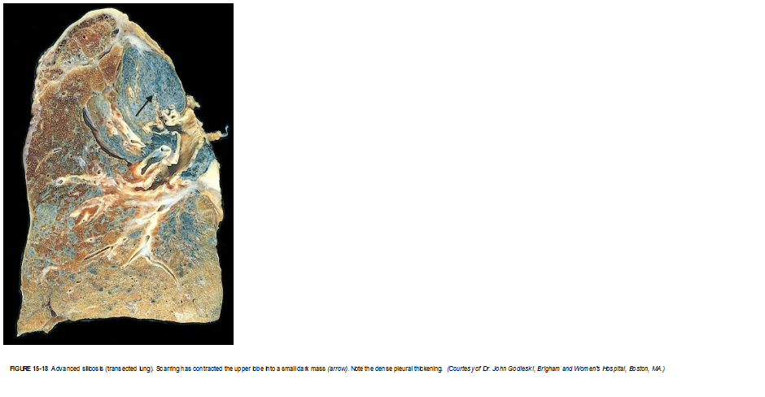

Slide 22
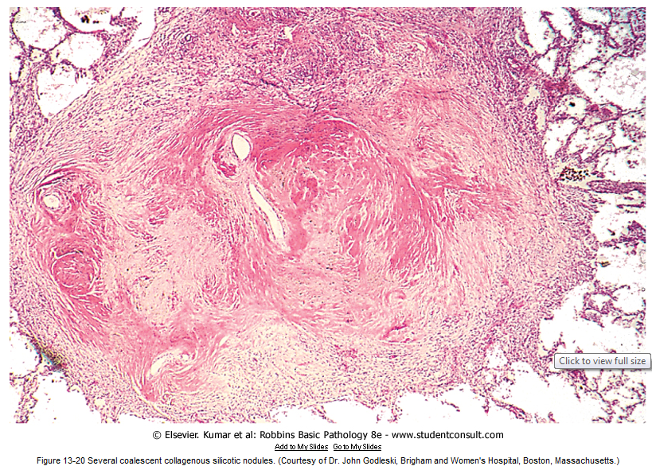

Slide 23
Clinical Course.
Chest radiographs typically show a fine nodularity in the upper zones of the lung, but pulmonary functions are either normal or only moderately affected.
Most patients do not develop shortness of breath until late in the course, after progressive massive fibrosis is present.
The disease may be progressive even if the patient is no longer exposed.
The disease is slow to kill, but impaired pulmonary function may severely limit activity.

Slide 24
Silicosis is associated with an increased susceptibility to tuberculosis.
It is postulated that silicosis results in a depression of cell-mediated immunity, and crystalline silica may inhibit the ability of pulmonary macrophages to kill phagocytosed mycobacteria.
Nodules of silicotuberculosis often display a central zone of caseation.
The relationship between silica and lung cancer is contentious.
In 1997, the International Agency for Research on Cancer (IARC) concluded that crystalline silica from occupational sources is carcinogenic in humans.

Slide 25
Asbestos-Related Diseases
Asbestos is a family of crystalline hydrated silicates that form fibers.
Use of asbestos is seriously restricted in many developed countries
there is little control in less developed parts of the world.
On the basis of epidemiologic studies, occupational exposure to asbestos is linked to
Localized fibrous plaques or, rarely, diffuse pleural fibrosis
Pleural effusions
Parenchymal interstitial fibrosis (asbestosis)
Lung carcinoma
Mesotheliomas
Laryngeal and perhaps other extrapulmonary neoplasms, including colon carcinomas

Slide 26
An increased incidence of asbestos-related cancer in family members of asbestos workers has alerted the general public to the potential hazards of asbestos in the environment.
The proper public health policy toward low-level exposures that might be encountered in old buildings or schools is unsettled
Some experts question the wisdom of expensive asbestos abatement programs for environments with airborne fiber counts that are as much as 100-fold lower than allowed by occupational standards.

Slide 27
Pathogenesis.
Concentration, size, shape, and solubility of the different forms of asbestos dictate whether it causes disease.
There are two distinct geometric forms of asbestos: serpentine and amphibole.
The serpentine chrysotile chemical form accounts for most of the asbestos used in industry.
Amphiboles, even though less prevalent, are more pathogenic than chrysotiles particularly with respect to induction of malignant pleural tumors (mesotheliomas).
The greater pathogenicity of amphiboles is apparently related to their aerodynamic properties and solubility.

Slide 28
Chrysotiles, with their more flexible, curled structure, are likely to become impacted in the upper respiratory passages and removed by the mucociliary elevator.
Furthermore, once trapped in the lungs, chrysotiles are gradually leached from the tissues because they are more soluble than amphiboles.
In contrast, the straight, stiff amphiboles may align themselves in the airstream and thus be delivered deeper into the lungs, where they can penetrate epithelial cells and reach the interstitium.
Both amphiboles and serpentines are fibrogenic, and increasing doses are associated with a higher incidence of all asbestos-related diseases except mesothelioma, which is only associated with amphibole exposure.

Slide 29
In contrast to other inorganic dusts, asbestos can also act as a tumor initiator and promoter.
Some of its oncogenic effects are mediated by reactive free radicals generated by asbestos fibers, which preferentially localize in the distal lung, close to the mesothelial layers.
Potentially toxic chemicals adsorbed onto the asbestos fibers most likely contribute to the oncogenicity of the fibers.
For example, the adsorption of carcinogens in tobacco smoke onto asbestos fibers may well contribute to the remarkable synergy between tobacco smoking and the development of lung carcinoma in asbestos workers.

Slide 30
One study of asbestos workers found a fivefold increase of lung carcinoma with asbestos exposure alone, while asbestos exposure and smoking together led to a 55-fold increase in the risk of lung cancer.
The occurrence of asbestosis, like the other pneumoconioses, depends on the interaction of inhaled fibers with lung macrophages and other parenchymal cells.
The initial injury occurs at bifurcations of small airways and ducts, where the asbestos fibers land and penetrate.
Macrophages, both alveolar and interstitial, attempt to ingest and clear the fibers and are activated to release chemotactic factors and fibrogenic mediators that amplify the response.
Chronic deposition of fibers and persistent release of mediators eventually lead to generalized interstitial pulmonary inflammation and interstitial fibrosis.

Slide 31
Morphology.
Asbestosis is marked by diffuse pulmonary interstitial fibrosis, which is indistinguishable from diffuse interstitial fibrosis resulting from other causes, except for the presence of multiple asbestos bodies.
Asbestos bodies appear as golden brown, fusiform or beaded rods with a translucent center and consist of asbestos fibers coated with an iron-containing proteinaceous material.
They arise when macrophages attempt to phagocytose asbestos fibers; the iron is presumably derived from phagocyte ferritin.
Other inorganic particulates may become coated with similar iron-protein complexes and are called ferruginous bodies.
Rare single asbestos bodies can be found in the lungs of normal people.

Slide 32
Asbestosis begins as fibrosis around respiratory bronchioles and alveolar ducts and extends to involve adjacent alveolar sacs and alveoli.
The fibrous tissue distorts the architecture, creating enlarged airspaces enclosed within thick fibrous walls; eventually the affected regions become honeycombed.
The pattern of fibrosis is similar to that seen in UIP, with fibroblastic foci and varying degrees of fibrosis, the onlydifference being the presence of numerous asbestos bodies.
In contrast to CWP and silicosis, asbestosis begins in the lower lobes and subpleurally.
The middle and upper lobes of the lungs become affected as fibrosis progresses.
The scarring may trap and narrow pulmonary arteries and arterioles, causing pulmonary hypertension and cor pulmonale.

Slide 33
Pleural plaques, the most common manifestation of asbestos exposure, are well-circumscribed plaques of dense collagen, often containing calcium.
They develop most frequently on the anterior and posterolateral aspects of the parietal pleura and over the domes of the diaphragm.
The size and number of pleural plaques do not correlate with the level of exposure to asbestos or the time since exposure.
They do not contain asbestos bodies; however, only rarely do they occur in individuals who have no history or evidence of asbestos exposure.

Slide 34
Uncommonly, asbestos exposure induces pleural effusions, which are usually serous but may be bloody.
Rarely, diffuse visceral pleural fibrosis may occur and, in advanced cases, bind the lung to the thoracic cavity wall.
Both lung carcinomas and mesotheliomas (pleural and peritoneal) develop in workers exposed to asbestos.
The risk of lung carcinoma is increased about fivefold for asbestos workers; the relative risk of mesotheliomas, normally a rare tumor (2 to 17 cases per 1 million persons), is more than 1000-fold greater.
Concomitant cigarette smoking greatly increases the risk of lung carcinoma but not that of mesothelioma.

Slide 35
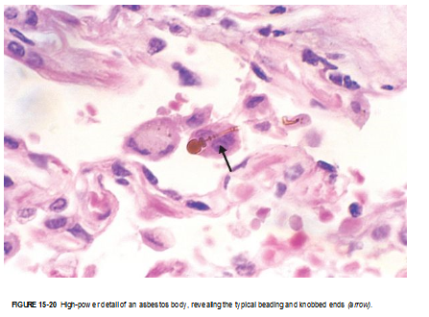

Slide 36
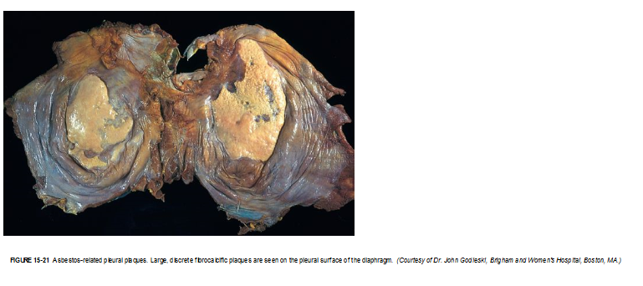

Slide 37
Clinical Course.
The clinical findings in asbestosis are very similar to those caused by other diffuse interstitial lung diseases
Dyspnea is usually the first manifestation
At first, it is provoked by exertion, but later it is present even at rest.
The dyspnea is usually accompanied by a cough associated with production of sputum.
These manifestations rarely appear fewer than 10 years after first exposure and are more common after 20 years or more.
Chest x-rays --- irregular linear densities----in both lower lobes.
With advancement---- honeycomb pattern
The disease may remain static or progress to respiratory failure, cor pulmonale, and death.
Pleural plaques are usually asymptomatic
Are detected on radiographs as circumscribed densities.
Asbestosis complicated by lung or pleural cancer ----grim prognosis.

Slide 38
Thank you.

