Slide 1
VITAMIN A

Slide 2
Vitamin Facts

Slide 4
Vitamin A

Slide 5
Retinol (Vitamin A alcohol)

Slide 6
Retinal (Vitamin A aldehyde)

Slide 7
Retinoic acid (vitamin A acid)

Slide 8
β – Carotene (pro-vitamin A)

Slide 9
Absorption of vitamin A

Slide 10
Absorption of vitamin A

Slide 11
Transport from liver to tissues:

Slide 12
Transport from liver to tissues:

Slide 13
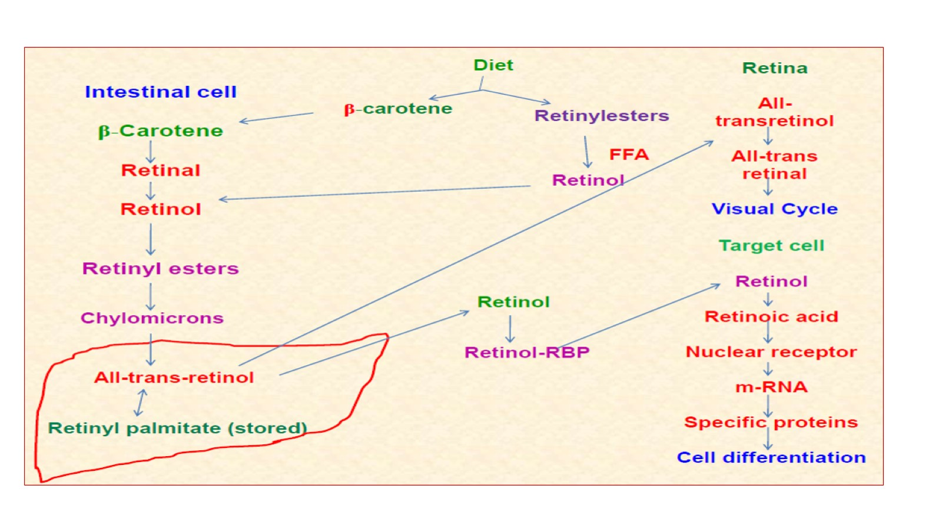

Slide 15
Physiological role and actions

Slide 16
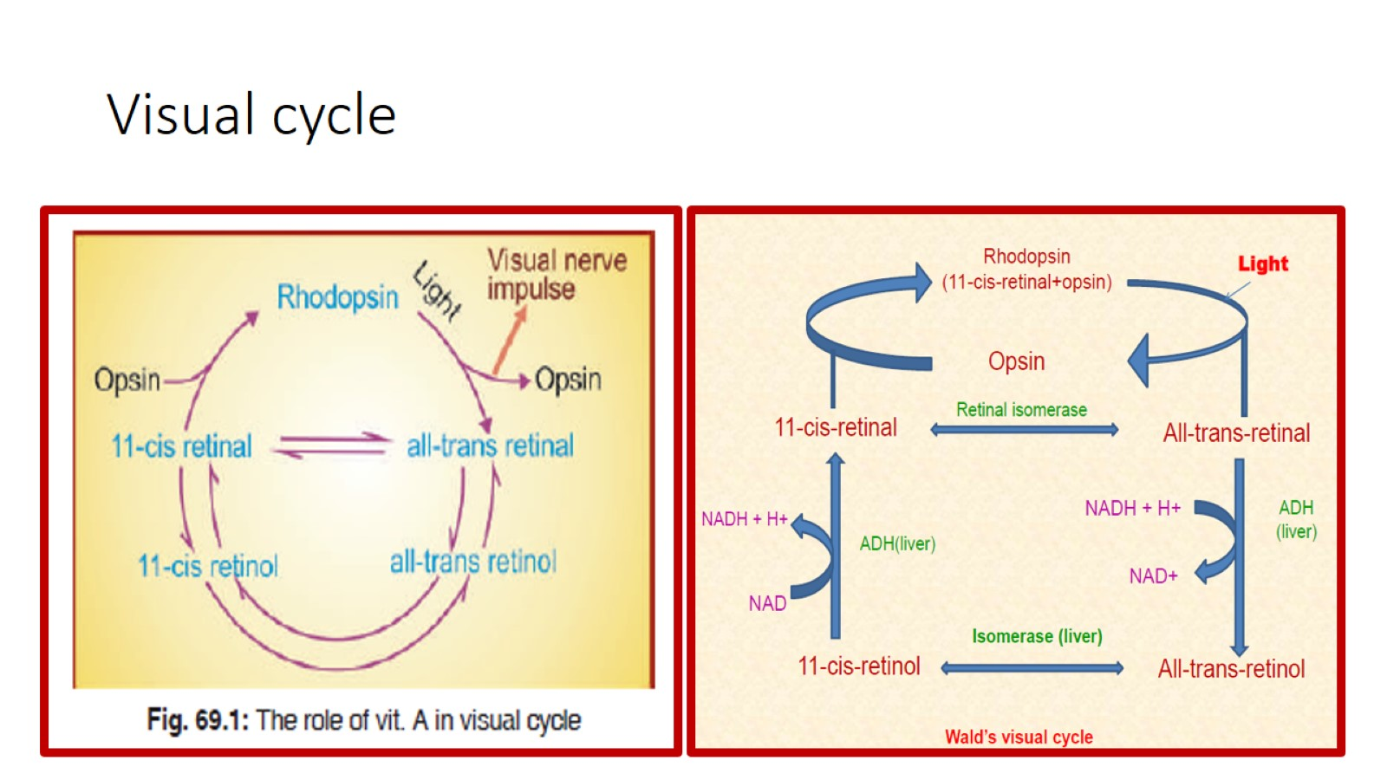
Visual cycle

Slide 17
a) Visual cycle

Slide 18
b) Epithelial tissue

Slide 21
Deficiency of vitamin A

Slide 22
Deficiency of vitamin A

Slide 23
Therapeutic uses

Slide 24
Interactions

Slide 25
Hypervitaminosis A

Slide 26
Hypervitaminosis A

Slide 27
Hypervitaminosis A

Slide 28
Thank you . . .

